Slide 1
PRESS A FOR ASSISTANCE
Making Games Accessible With AI
Veronica Reingold and Steven Rice
Notes:
Title Card:
Press A for Assistance: Making Games Accessible with AI
Veronica Reingold and Steven Rice

Slide 2
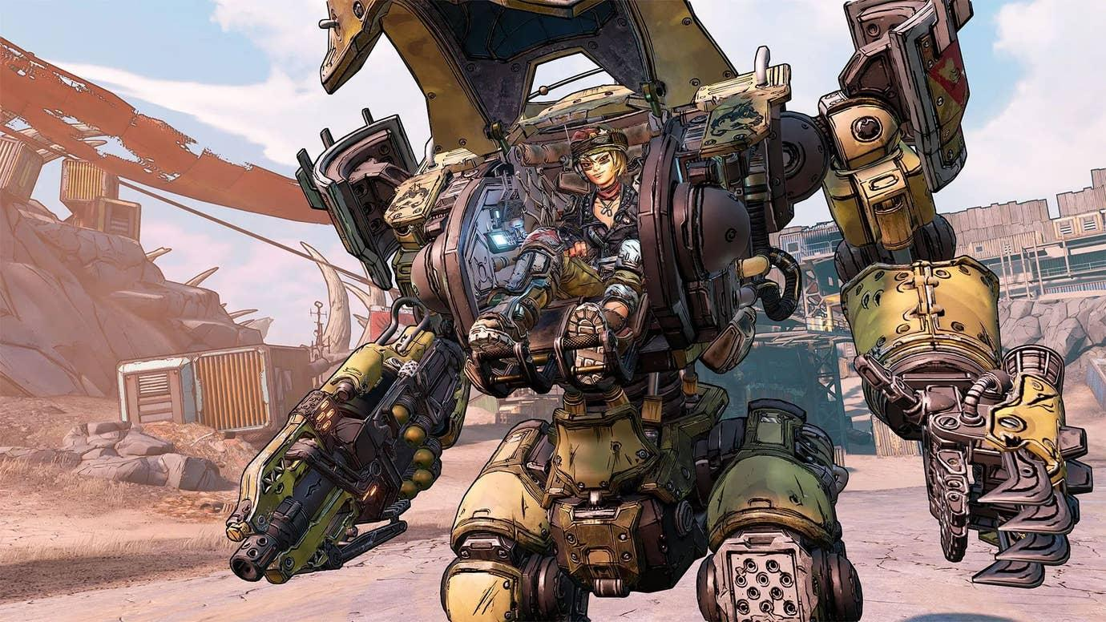
Borderlands 3 - Gearbox Software
2
Notes:
Nonika
A while back, I was talking to Steven about games, and I recommended that he play through the Borderlands franchise. They’ve got cool guns and mechanics, unique enemies, and a super fun universe!
Steven
The unfortunate reality is, with how busy I am, I have maybe an hour or two a week these days to play games, if even that. I know I would enjoy Borderlands, but following the story or remembering all the weapons customization and mechanics after a long break would be hard for me. Maybe I’m just a very good student for prioritizing school over games. But maybe I’m not the only one struggling with issues like this.

Slide 3
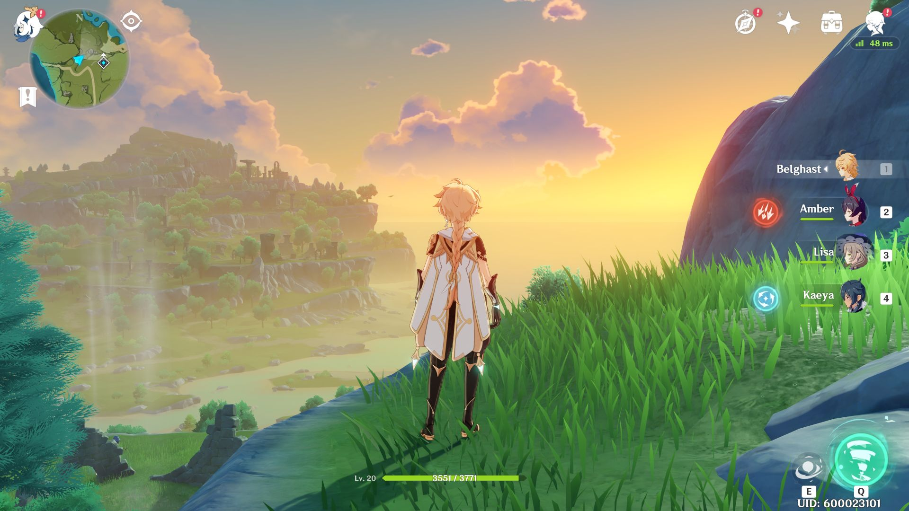
Genshin Impact - miHoYo
3
Notes:
Nonika
You’re definitely not the only one. I remember first launching Genshin Impact, chasing crabs along the shore, and then entering the forest where I foraged for fruit, mushrooms, and flowers. The movement and combat mechanics were quite easy to pick up. But soon enough, I had multiple characters, the characters had elemental powers, the elemental powers synergized together, the characters had to be individually levelled up and equipped with items and trinkets…

Slide 4
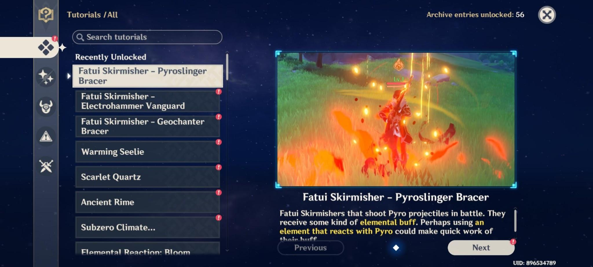
Expensive-Session152 - Reddit
4
Notes:
Nonika
And within just a few hours, I had collected a mini textbook of tutorials. I got overwhelmed, and uninstalled the game. It wasn’t until a friend offered to teach me a year later that I gave Genshin another try. Turns out, I wasn’t the only one either.

Slide 5
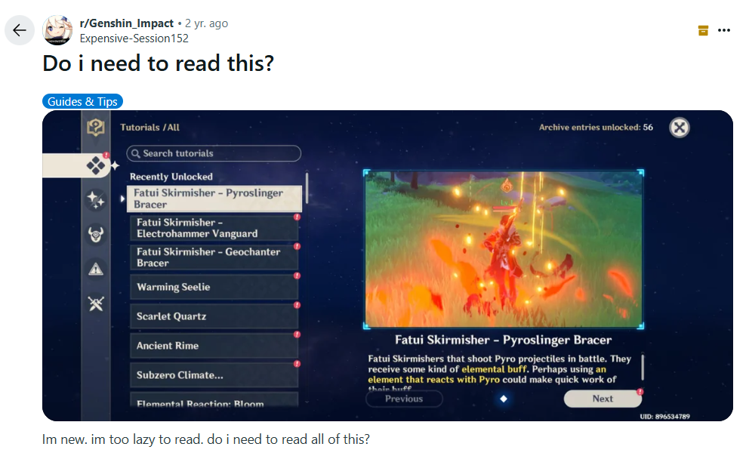
5
Notes:
Nonika
In terms of tutorial best practices, Genshin Impact did nothing wrong. It introduced mechanics a little at a time and allowed the player to practice each mechanic before introducing another one. Having the ability to reread the tutorials at any time is also incredibly important--players might want to refer back to the tutorials in case that accidentally skipped something, or if they just need a refresher. But text-based instructions clearly have their faults: they’re kinda boring.

Slide 6
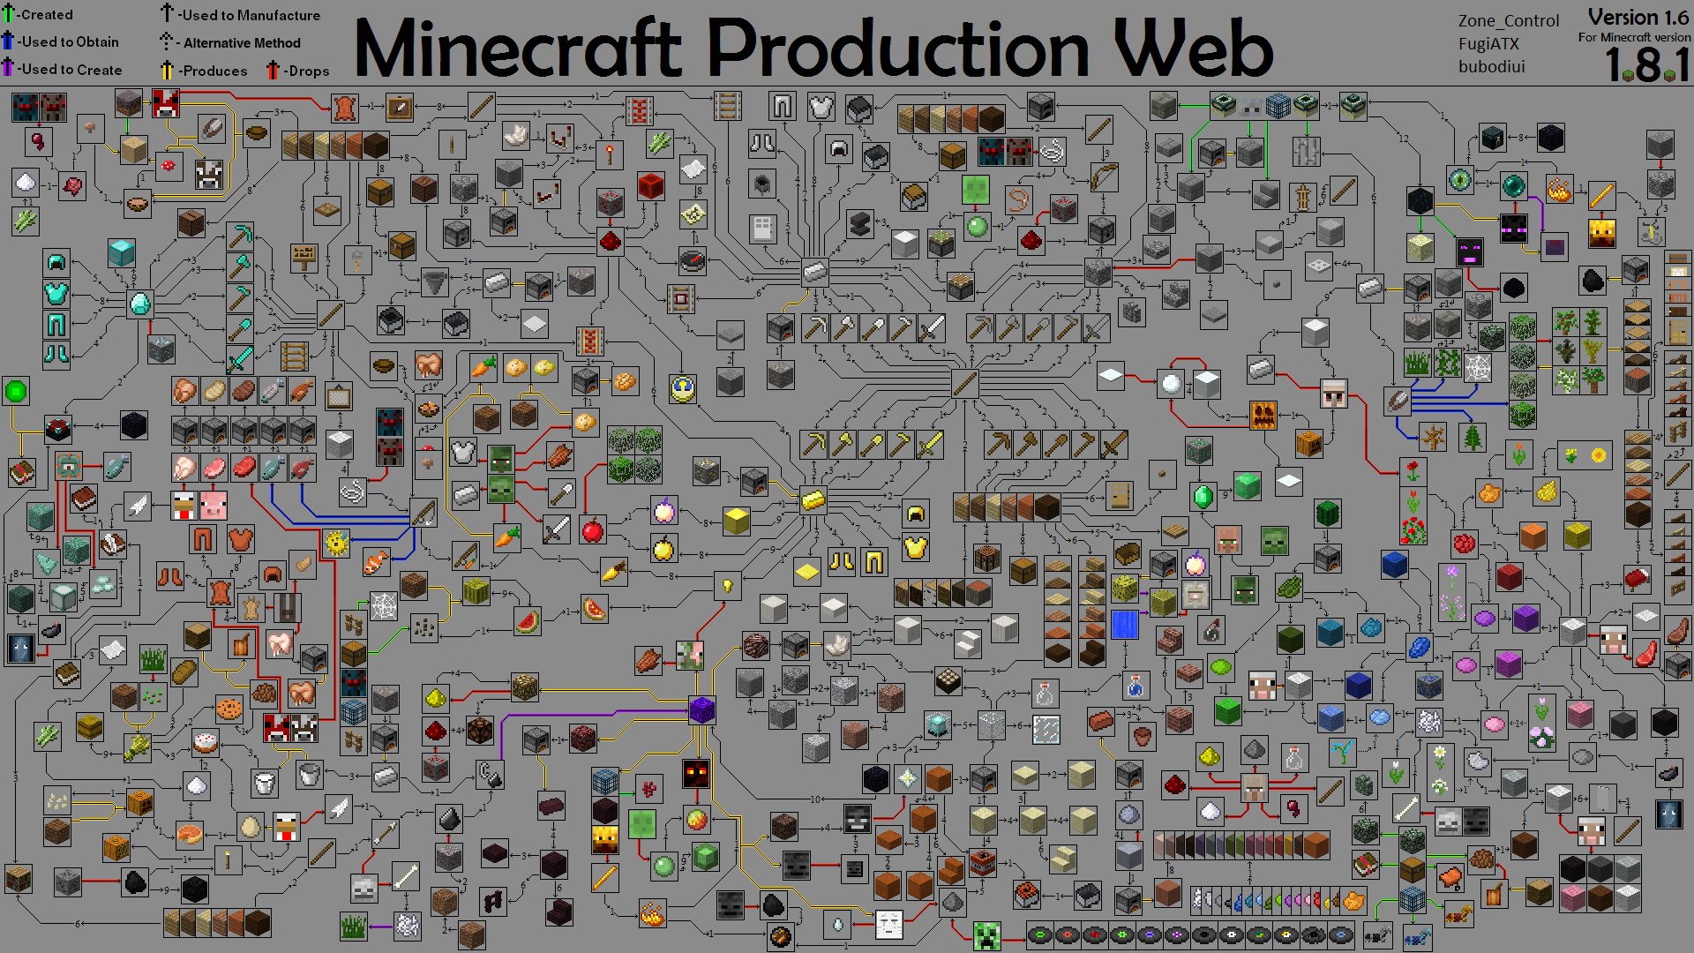
bubodiui - Reddit
6
Notes:
Steven
Here’s another example: This is a fan-made production web which details how to get every single item in Minecraft. It was last updated 11 years ago. With how many items and mobs have been introduced over the years, I certainly don’t blame the creator for not attempting to map all of that out.

Slide 7
PRESS A FOR ASSISTANCE
Making Games Accessible With AI
7
Notes:
Steven
That is why both of us having a background in games and AI figured, why not try to explore how we can make games more accessible using AI.

Slide 8



“Nonika”
Veronica Reingold
MSc in Computer Science University of Windsor
Researching Accessibility
Vector Scholarship in AI
nonika.ca
8
Notes:
Nonika
Hi, I’m Nonika, and I’m a Master’s student at the University of Windsor. I’ve always loved video games. I started programming simple games in high school using Java, and during my Bachelor’s degree I learned Unity, C#, and AI for games. I also did a minor in Communication, Media, and Film, which gave me a really good understanding of captivating audiences and online communities.
Right now, I’m working on my Master’s degree, where I’m researching applying AI to accessibility and user experience in games! My thesis proposal not only got me the Vector Scholarship in AI, but it also gave me the opportunity to fly out here to England and discuss it with industry professionals at the AI and Games conference, so I’m super excited to be here!

Slide 9

Steven Rice
PhD in Computer Science
University of Windsor
Robotics
Simulations
Artificial Intelligence
stevenrice.ca
9
Notes:
Steven
Hi I’m Steven! Been making video games since around five years old starting with “The 3D Gamemaker” if anyone has ever even heard of that. Got into Unity development when I was still in elementary school–back then it even had a Python like language called Boo. While I started with making games most of my experience over time really branched out more into the world of robotics and industrial manufacturing, using tools like Unity to rig simulations and digital twins. I’d like to say I was doing it before it really started to become popular to do so. Throughout all that my main passion is still games and I’ve taught game development at the University of Windsor and the University of Detroit Mercy.

Slide 10
Terminology
Accessibility | accommodations for individuals with disabilities*
Approachability | early game: tutorials and communities
Learnability | late game: tutorials and mastery
Difficulty | game challenge and personal skills
User Experience | effectiveness of game, HUD, and UI
10
Notes:
Nonika
Let’s quickly go over some terminology that’s important to this talk.
Accessibility is an area of research and laws that implement accommodations for people with disabilities.
Approachability focuses on the first few minutes or hours of gameplay, mainly the onboarding process and how welcoming your game community is.
Learnability has to do with game mastery--how much can your playerbase improve their skills, and how your game and tutorials support their learning.
Difficulty is a combination of the game challenge as well as personal skills. For example, I’m not very good at first-person shooter games, I’m like a high bronze in Overwatch if I really grind out comp. Steven ranked Master in his prime. If we were to try a brand new first-person shooter, Steven would obviously pick it up much quicker than me, and find it easier than I do.
Finally, user experience relates to the overall effectiveness of your game, as well as your HUD, and your UI. This is where it gets a bit confusing, because in terms of video game research, some scholars will use the term “accessibility” to mean ease of use or user experience. And yet, in the video games themselves, the “accessibility” page has options for accommodating gamers with disabilities.
While I think it’s incredibly important to discuss accessibility and user experience separately in certain contexts, for this talk, we can let this muddying of terms slide. Why is that?

Slide 11
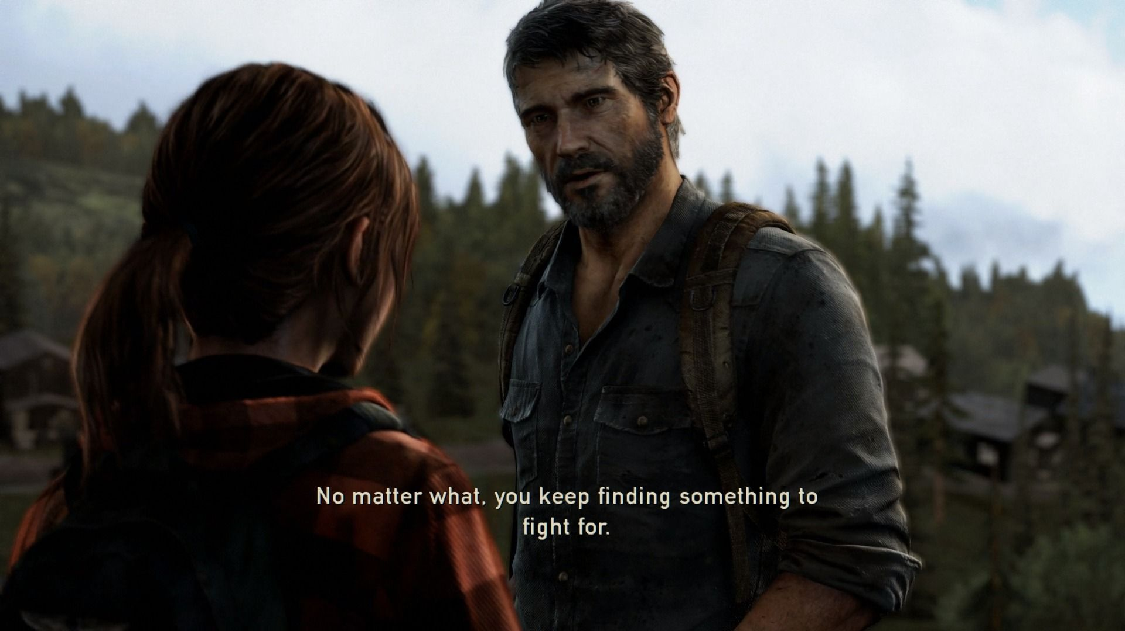
The Last of Us - Naughty Dog
11
Notes:
Nonika
Subtitles are a great example. Can you please put your hand up if you use subtitles for games, movies, or shows. Keep your hands up please. Now, put your hand down if you have a disability that affects your hearing. I’m sure you all have your own reasons for using subtitles, because they’re useful for everyone, not just people with disabilities!
V2: Subtitles are a great example. You may be deaf, or hard of hearing, or have audio processing issues. Maybe the game has poor audio balancing. Or maybe, you’re in public or in a noisy room and you don’t have headphones. There are plenty of reasons why someone might choose to use subtitles--that makes them important in both accessibility and in overall user experience!

Slide 12
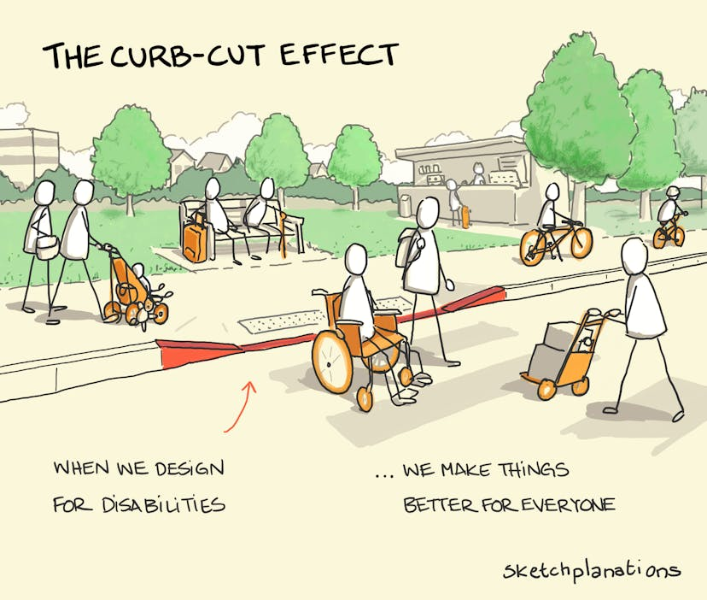
Curb-Cut Effect
Originally made made for wheelchair users, curb cuts are a fantastic example of how accessibility features benefit all users!
Sketchplanations
12
Notes:
Nonika
This brings us to the curb-cut effect. Curb cuts were created for wheelchair users thanks to the hard work of disability advocates. Once they became a standard, it turned out that they’re quite useful for everyone--not just wheelchair users, but people riding bicycles and skateboards, parents with strollers, and delivery carriers. We certainly found them helpful for bringing our luggage to our hotel here in London!
Conversely, quality of life or user experience improvements that are not intended as an accommodation may prove to be very useful for specific disabilities as well! Accessibility and user experience go hand-in-hand, and for the purposes of our presentation, we will discuss them as one broad topic.

Slide 13
Myth:
Fact:
Accessibility options make games easier.
Accessibility options remove barriers without impacting difficulty.
Elevators make it too easy to get to the 12th floor. - Nobody
“
13
Notes:
Steven
We quickly want to address the idea that accessibility options make games easier, because it’s not true. The goal of accessibility options is to remove barriers without impacting difficulty. For example, I don’t think that anybody has ever complained that elevators make it too easy to get to the 12th floor.

Slide 14
Guidelines
Video games feature an incredible diversity of genres, styles, difficulties, audiences, and game loops.
There’s no one-size-fits-all standard to accessibility and user experience!
In real life
stairs → install ramp or elevator
In a game
??? → ?????
14
Notes:
Steven
In real life, the guidelines are quite simple. If you have a set of stairs, you need to provide a ramp or an elevator as an option. But video games are so diverse, with different genres, styles, and difficulties, which can make it difficult to identify what the metaphorical stairs are in your game, and what metaphorical ramps or elevators you should implement.

Slide 15
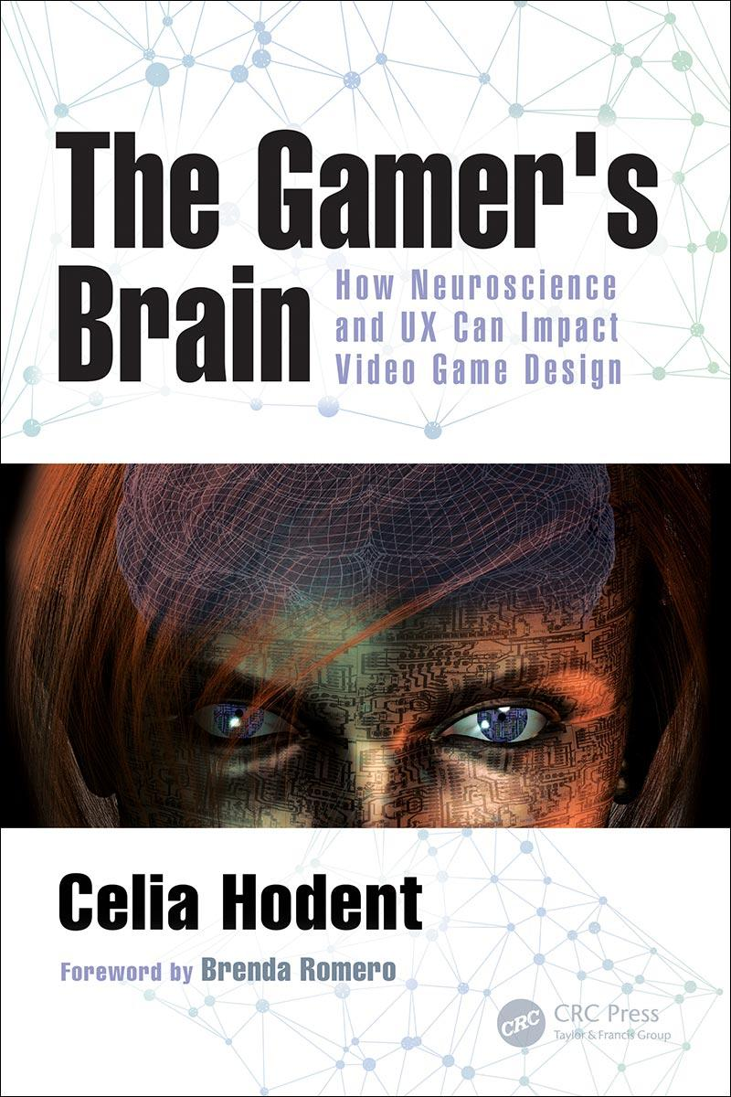
Guidelines
Keywords: Game accessibility, user experience, approachability, learnability, tutorials, etc.
Accessibility:
gameaccessibilityguidelines.com
accessible.games/accessible-player-experiences
caniplaythat.com
Games User Experience:
gamesur.com
thegamersbrain.com
15
Notes:
Nonika
Thankfully, there’s a ton of resources out there, and I’m sure you’ll find exactly what you’re looking for just by googling the keywords (whatever you may be focused on for your specific game). We’ll highlight a few here, mainly regarding accessibility, which are: GAG, APX, and CIPT. If you’re interested in more general user experience, these two are great resources as well. The Gamer’s Brain is a book that I read front to back which focuses on the intersection of user experience and the cognitive aspect of video games. Why the cognitive aspect?

Slide 16

Guidelines
Guidelines are grouped by disability for our convenience!
Our focus today is on cognitive accessibility and assistance—things that impact both disabled and non-disabled gamers!
Can I Play That?
16
Notes:
Nonika
Typically, accessibility resources group things by disabilities. The focus of my research is on the cognitive category, which includes perception, attention, learning, and memory. These are areas that impact both disabled and non-disabled gamers. So let’s define them.

Slide 17
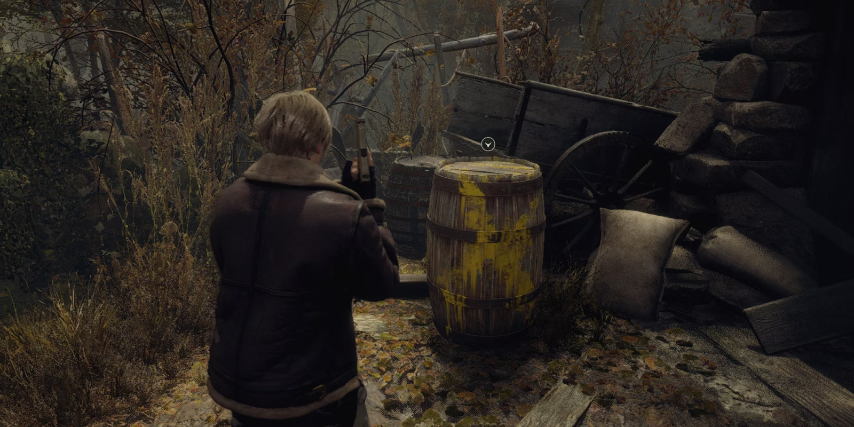
Perception
Resident Evil 4 Remake - Capcom
17
Notes:
Nonika
Perception relates to what players notice, and what they miss. In games with very busy, rich environments, it’s become easy for interactable objects or paths to be missed as just decor, so developers tend highlight important things with yellow paint, glowing light, or sparkly effects.

Slide 18
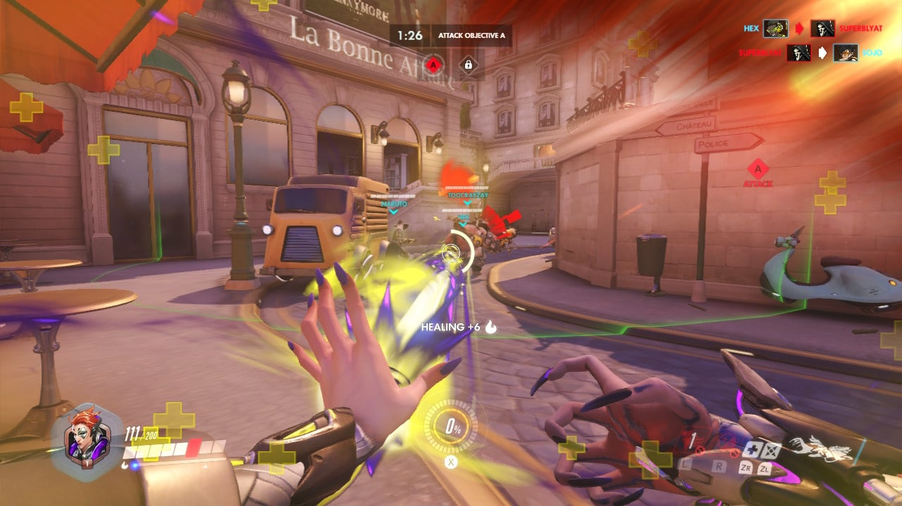
Attention
Overwatch - Blizzard Entertainment
18
Notes:
Nonika
Attention can be confused with perception, but it’s somewhat different. Attention has to do with which perceptions are retained and processed, and which ones are discarded. For example, when your player is in the middle of a teamfight, their attention is focused on the middle of the screen, where they look at their teammates and enemies, as well as the bottom of the screen, where they keep track of their health and ability status. Even though they may perceive deaths popping up in the killfeed located in the top right corner, they may not pay attention to who exactly died.

Slide 19
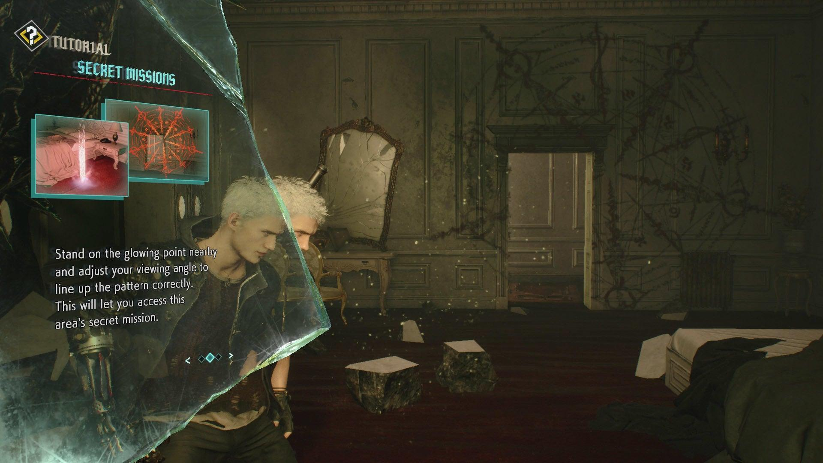
Learning
Devil May Cry 5 - Capcom
19
Notes:
Steven
I think we all intuitively understand what learning is, it’s the skills that players retain through tutorials and gameplay, and how they improve those skills.

Slide 20
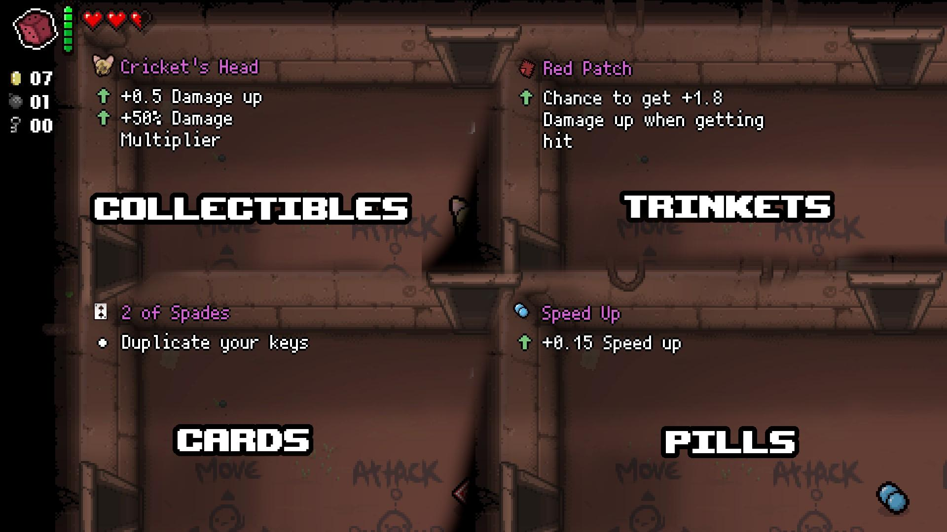
Memory
External Item Descriptions for Binding of Isaac
20
Notes:
Steven
Memory is a very intuitive one as well, and it has to do with what your players remember, and what they forget. This may be your game’s story, the controls, or the player or enemies’ abilities. In this image, you see a mod for The Binding Of Isaac which adds descriptions to in-game items. There’s so many different items, trinkets, cards, and pills, so it can be very hard to remember what exactly each one does.
You may notice that these areas already have some hard-coded solutions, like the yellow paint, text-based tutorials, and mods like this one. So where does AI come in?

Slide 21
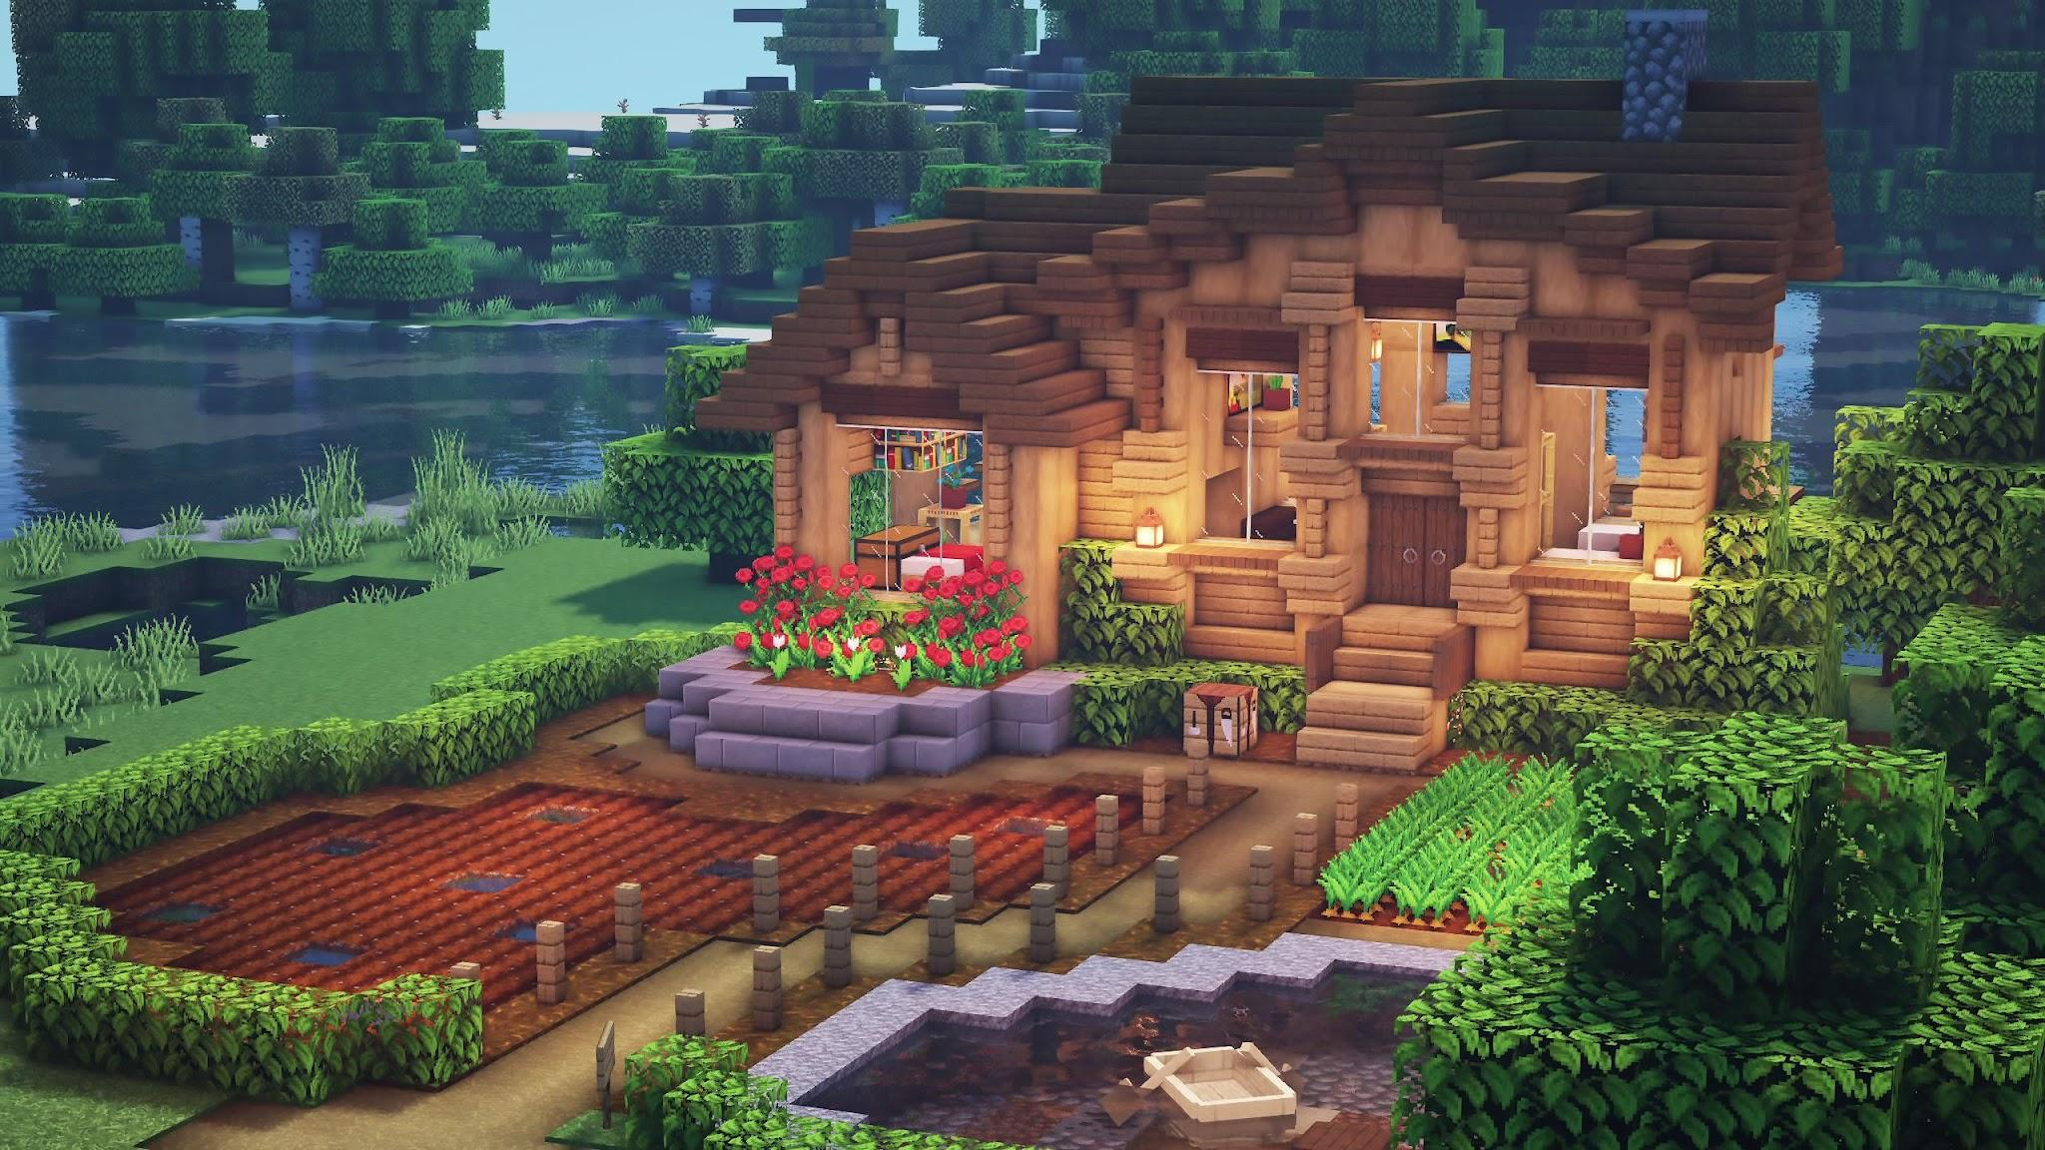
Virucraft - Reddit
21
Notes:
Nonika
To answer that, let’s revisit the problem. As video games have evolved, they’ve become more robust and realistic. Many modern games feature open environments, resource gathering, crafting, various enemies, player abilities, weapons, armour, and other items. Developers want players to be fully immersed in their video game worlds, to live inside that universe. But while video games have evolved so much, tutorials haven’t evolved enough to match.

Slide 22
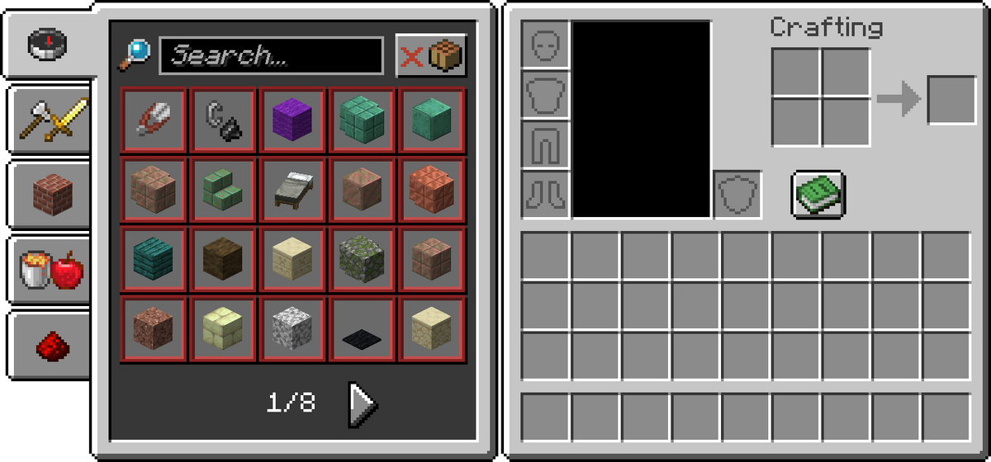
Recipe Book - Minecraft Wiki
22
Notes:
Nonika
Most games have at least some sort of tutorial or guide. Typically, game designers will try to keep these as brief as possible, because as we discussed at the beginning, players didn’t launch a game just to read a textbook.

Slide 23
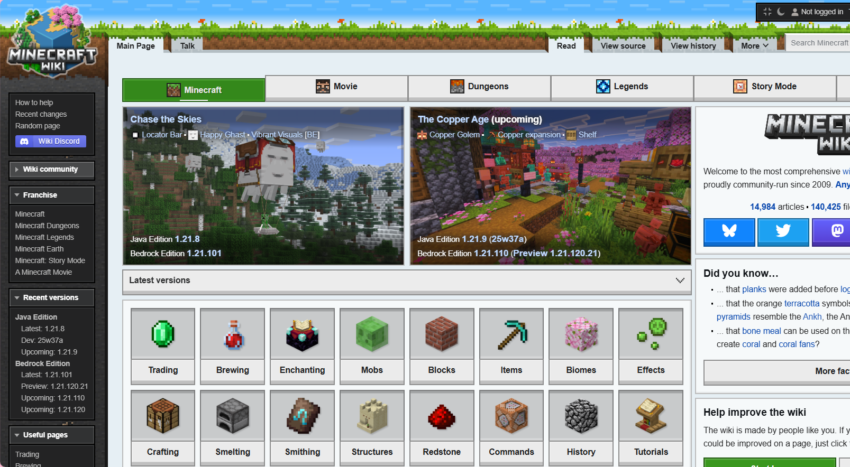
Minecraft Wiki Page
23
Notes:
Nonika
Naturally, the super passionate fans create wiki pages, which feature tutorials and tips, as well as in-depth explanations of game mechanics, enemies, and items. As a player, however, the only thing worse than reading a textbook in-game, is to have to pause your game, open Google, search the wiki, and THEN read a textbook.

Slide 24

AI Assistance
Large Language Models (LLMs) are great at summarizing!
Can we use LLMs to search the web and game wikis to provide contextual assistance to players?
University of Windsor
24
Notes:
Nonika
That’s what inspired my Master’s research at the University of Windsor. Large Language Models are fantastic at summarizing information, so can they provide contextual assistance to players by searching the internet and the game’s wiki page or other documents?

Slide 25
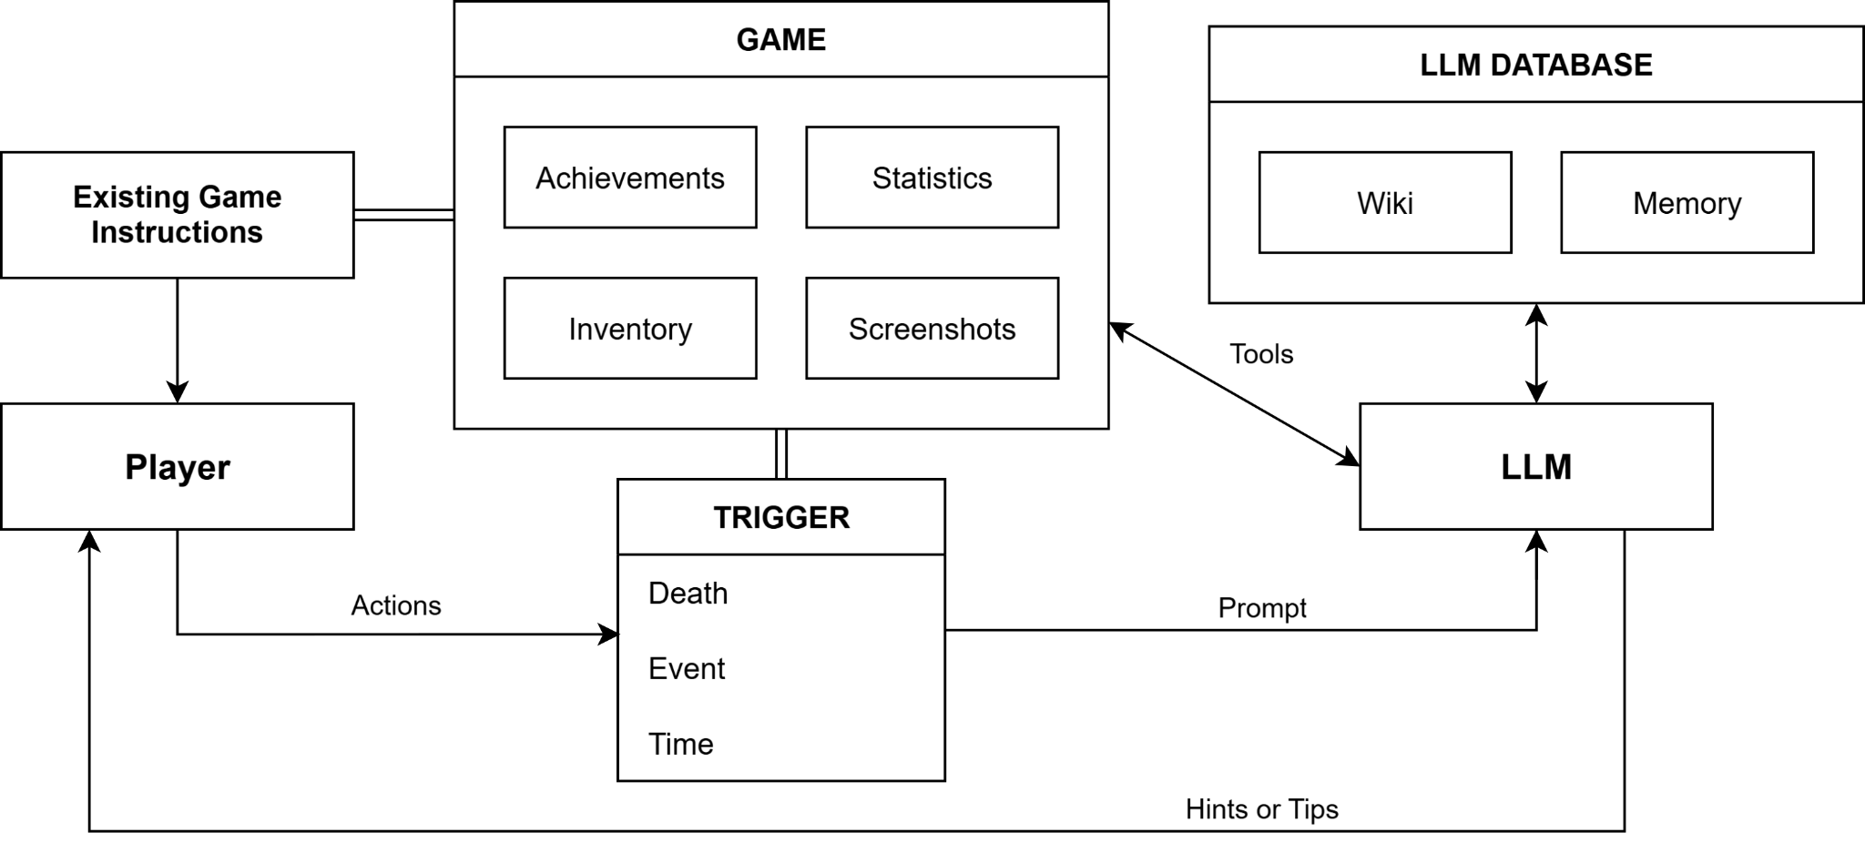
25
Notes:
Nonika
Here’s the architecture we came up with. There’s three main components here. Obviously we have the player who plays the game, triggers which prompt the LLM, and the LLM interacts with all the other components. Let’s walk through each of these.

Slide 26
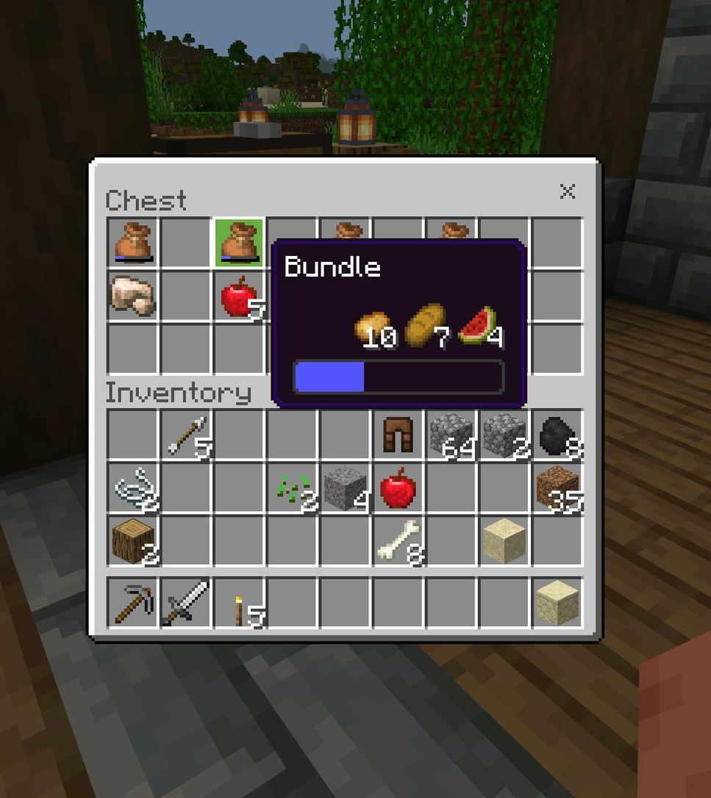
Game
Achievements
Items unlocked
Mechanics mastered
Monsters killed
Statistics
Kills, deaths, items, etc.
Inventory
Equipped or in storage
Screenshots
Minecraft - Instagram
26
Notes:
Nonika
So any game will have a ton of data which can be useful for contextual suggestions.
Achievements will keep track of what items the player has unlocked, what mechanics they’ve mastered, and which monsters they’ve killed--and by extension, which ones they didn’t. For example, is there a mechanic or ability that they’re not using?
That’s also heavily related to statistics: how many kills do they have, which abilities or weapons did they use to get those kills? How many deaths do they have, and what killed them?
Inventory is important and ties in as well. Is there an important item or weapon the player should acquire ASAP?
Finally, through screenshots, the LLM may be able to detect what the player is currently working on. Are they exploring? Building? Farming? Are there enemies nearby?
All of this information is important to make an informed, contextual “hint” or “tip”.

Slide 27
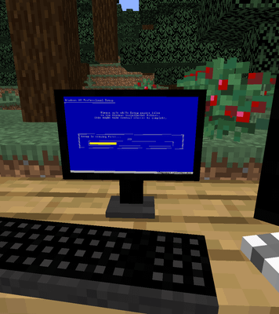
LLM Database
Tutorial/Wiki:
Items
Mechanics
Enemies
Tips
Memory:
Enemies encountered
Resources acquired
Game/player state save
BlackberryCareless26 - Reddit
27
Notes:
Steven
In addition to the game data, the LLM also needs a database to search. This could include the existing in-game tutorial, the fan-made wiki, or any other documents that provide information on items, mechanics, and enemies. The database will also have a memory section which might keep track of key gameplay events, and a recent game or player state save, in case the player dies and drops all their items, for example, we want to be able to check what they had equipped.

Slide 28
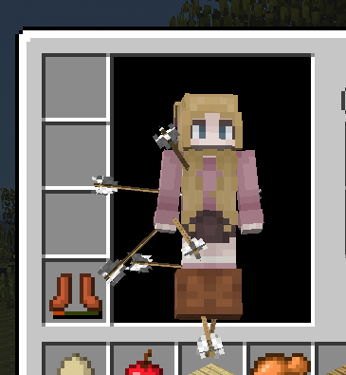
Trigger
Event:
Taking damage
Nature/monster effect
Death:
One or more causes
Time:
Time of day
Additional calls via timer
Manual
Nonika Getting Bones to Tame Wolves - Minecraft
28
Notes:
Nonika
Much like with any other game AI, we don’t want to make constant calls to the LLM--this is costly! Instead, we can call the LLM based on certain triggers.
These could be certain key events, like taking damage, or some sort of effect on the player such as poison, darkness, or dizziness. It’s important to note here that learning from trial and error is super important, so the goal isn’t for the LLM to be a backseat gamer. A trigger event should not always result in a hint or tip, but we’ll explore that later.
“Death” is a general concept here. Death could be a literal character death, but it could also be losing a squad in a strategy game, or losing a round in a card game.
In games with a day and night cycle, it may be useful to trigger a call at certain times during the day. We might also want to call the LLM based on some sort of timer--for example, if they haven’t made any “progress” in a few minutes.
Finally, we can have a manual button that players can use to call the LLM if they’re stuck.

Slide 29
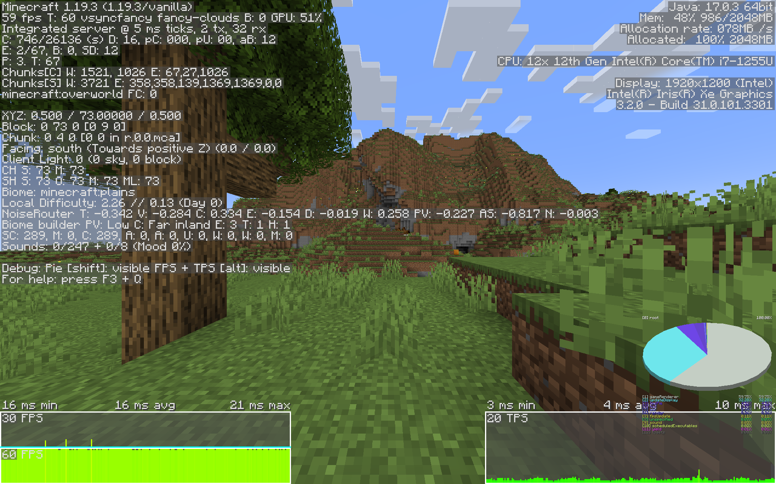
LLM Tools
Read - Text/Image
Database:
Game tutorial
Wiki
Memory
Game State:
Achievements
Statistics
Inventory
Coordinates - Minecraft Wiki
29
Notes:
Steven
When we make a call, based on the trigger, the LLM will have some basic information regarding the situation. For example, if the player’s death triggered the call, we can immediately tell the LLM that:
The player died.
Who or what killed them.
The armour or weapons the player had equipped.
Any other information that is directly relevant to the death: player level, enemy level/strength, the environment, and so on.
Of course the initial information will depend not only on the trigger type, but also the game that we apply this architecture to.
Now we don’t want to overwhelm the LLM and introduce noise, so initial prompts need to be short and sweet. However, we also want to provide the LLM some tools to gather additional information, as it deems necessary. So all the data we just discussed in the database and the game itself will be accessible to the LLM via these read calls. Most of this information can be encoded as text, but as Nonika mentioned, screenshots may be useful in certain situations as well!

Slide 30
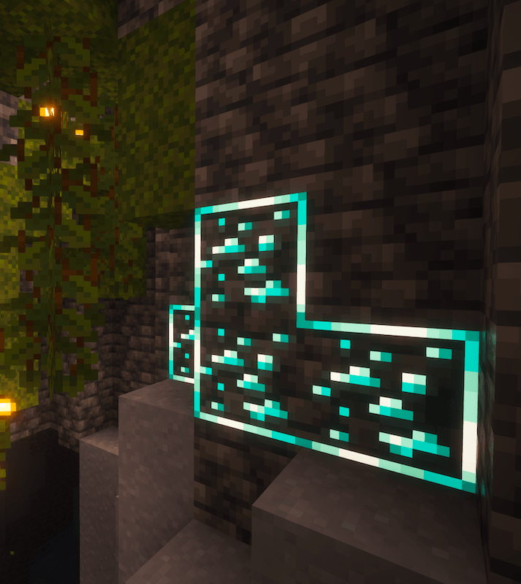
LLM Tools
Write
Print message to HUD
Memory
Attention
Highlight Item/Creature/etc.
Perception
Attention
“Show, don’t tell”
New Glowing Ores - CurseForge
30
Notes:
Steven
Depending on what the LLM thinks is best for the player, the other kind of tools available to it would be those that can write back to the game. In its simplest form, those can be messages written to the HUD such as tips. Depending on the game and what is made available to the LLM, it could visually interact with elements of the world to draw the player’s attention to items, creatures, locations, or anything else that may be important to the player. While summarizing long tutorials with short, 1-sentence tips is a fantastic improvement, it’s always best to show, not tell, when it comes to media.

Slide 31
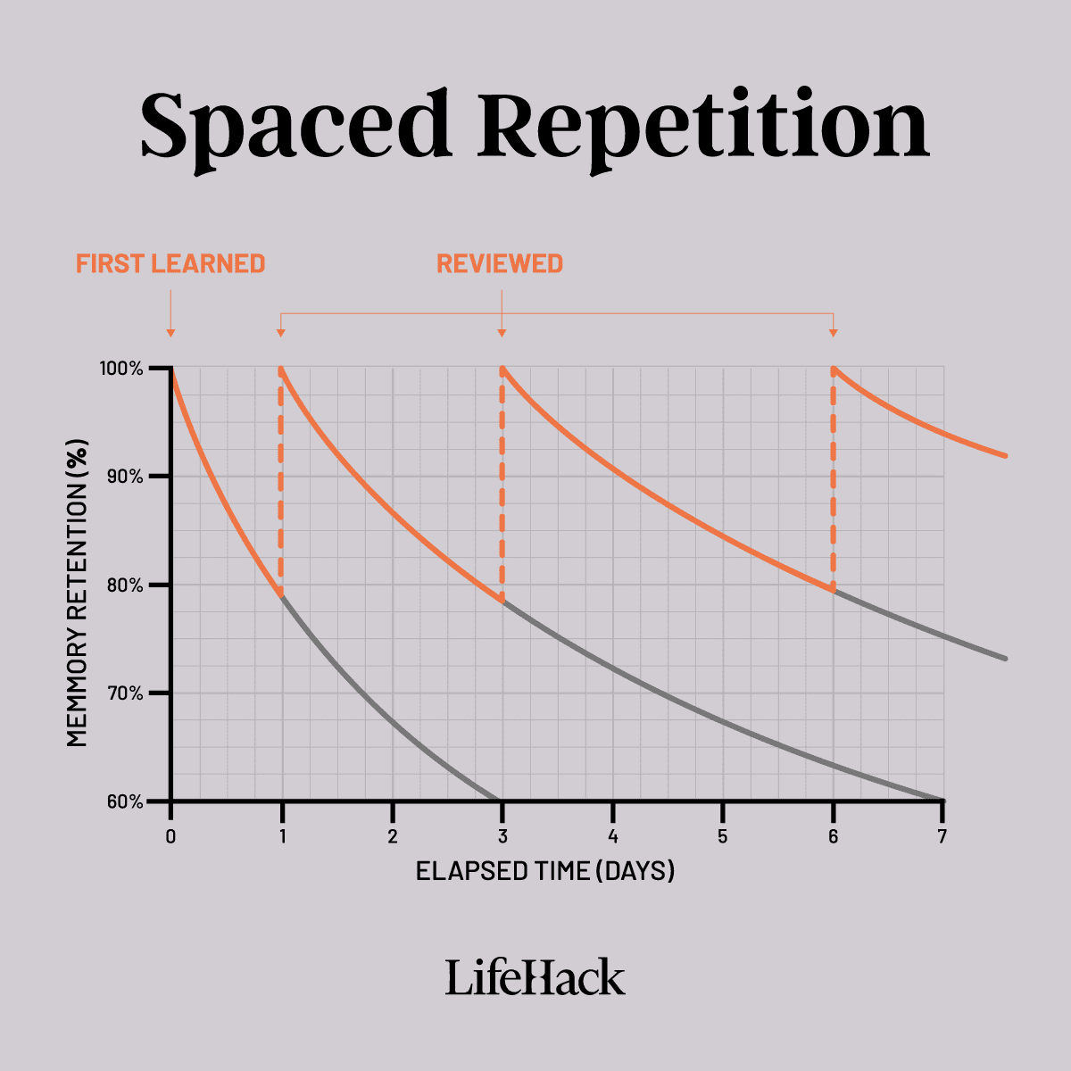
Considerations
Memory allocation
Developer and player control
Consistency
How can we get consistent, predictable assistance in a constantly-changing environment?
Spaced Repitition - LifeHack
31
Notes:
Steven
Now, what are the potential issues with using LLMs like this? The most obvious is memory allocation. For video games, we would want to run the LLM locally, which would take up some of the memory that could otherwise be used for the game itself.
The other issue is control. By using LLMs, both players and developers have a lot less control over the type and frequency of assistance given than if we were to use traditional, hard-coded approaches.
Finally, there’s the issue of consistency. Think about how you learn well, any skill. You need to practice and repeat it over and over. But if we’re using tips generated with LLMs to guide players, they’re likely going to return slightly different responses each time. Even if we set the temperature to 0, the player will likely be in a slightly different environment, with different statistics and items, so the LLM will interpret that situation differently, and produce a new tip.
So what can give us consistent, predictable assistance in a game environment that is constantly changing?

Slide 32
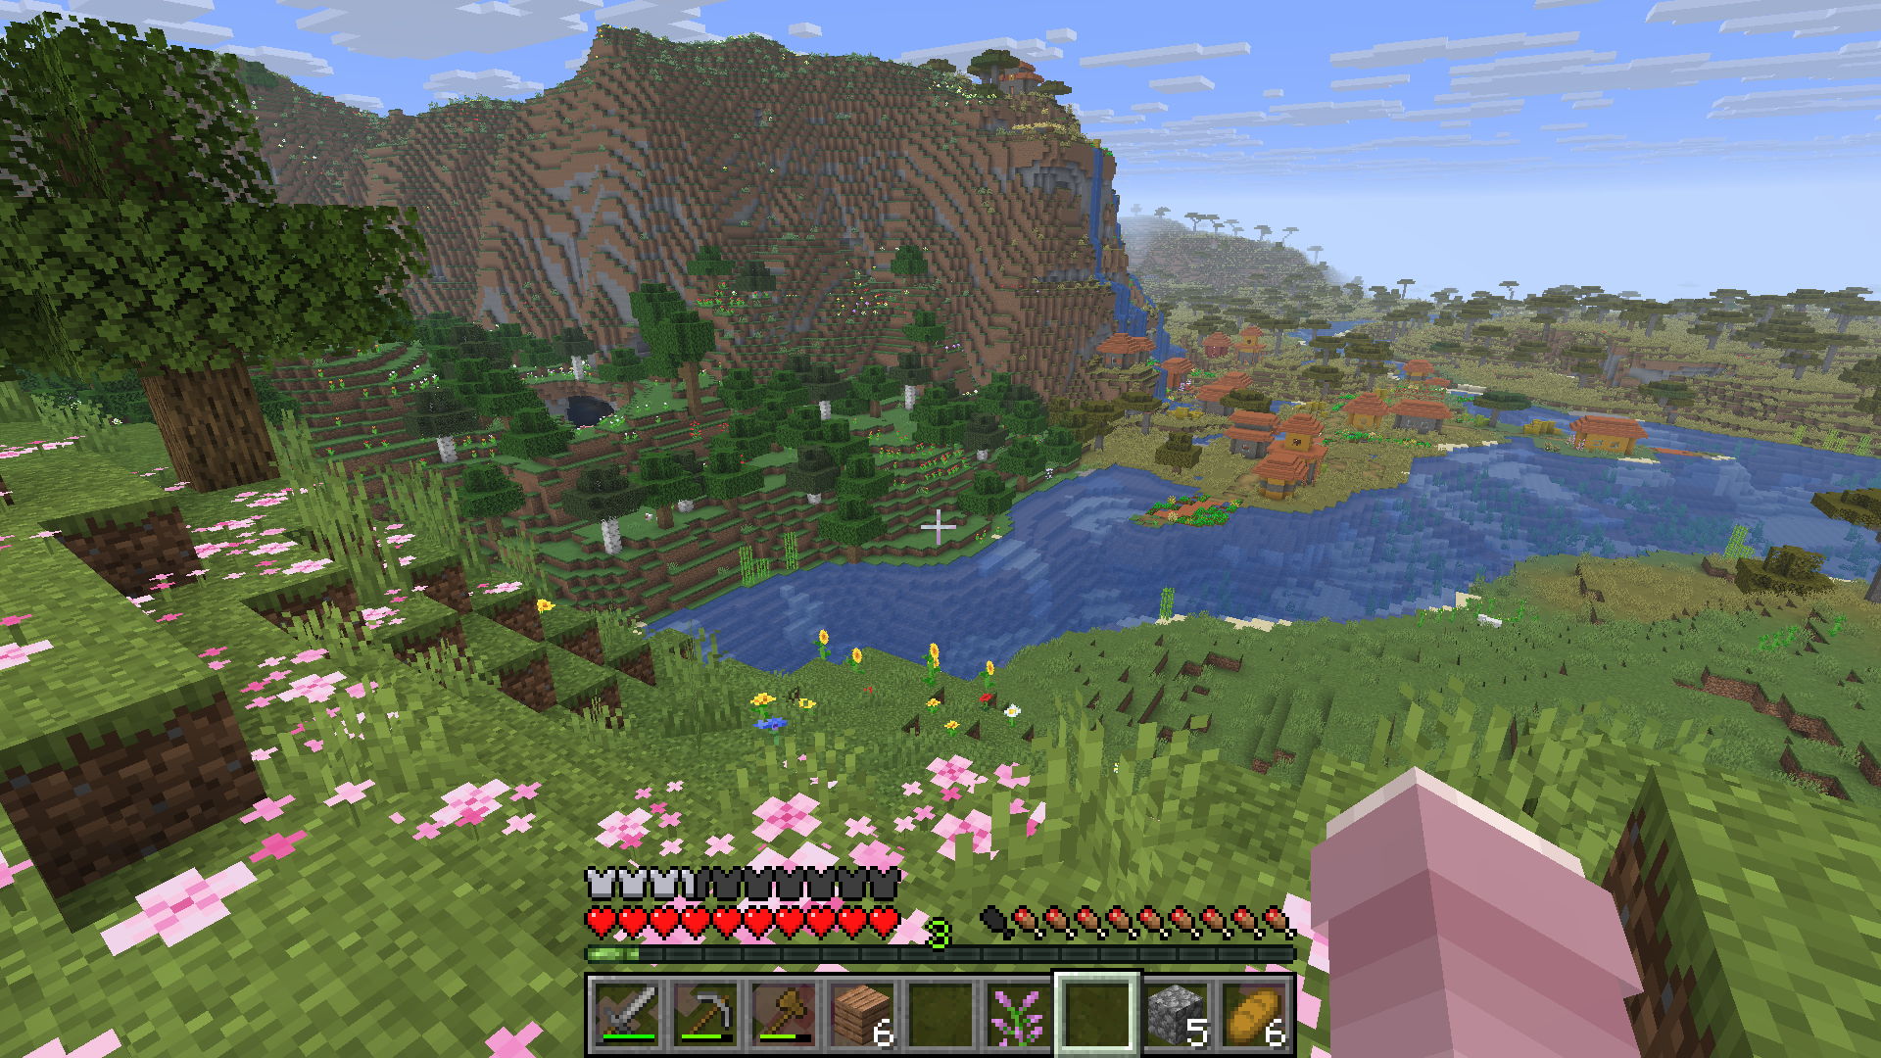
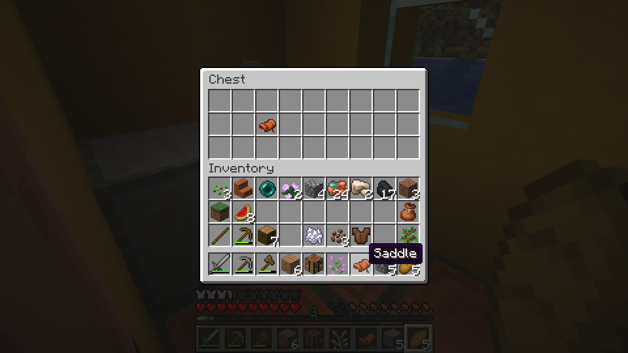
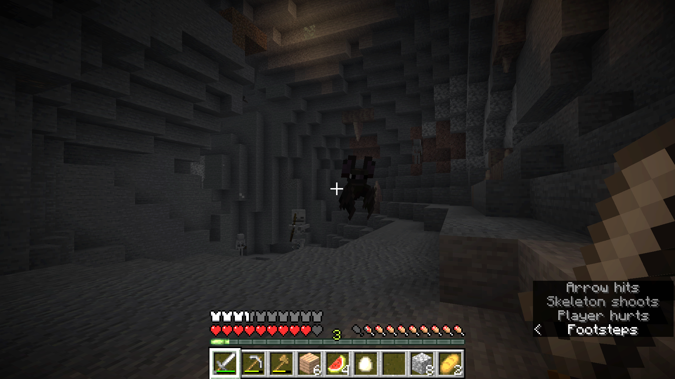
Minecraft - Mojang Studios
32
Notes:
Nonika
Let’s start with a concrete example, suppose our player is trying to get iron. They know they need to go mine for it, but there’s a village, and they’ll just take a quick look. Oh cool, they found some saddles! Weren’t there horses around this area? They might look around for one, and bring it back home, or at least drop off their loot before going caving. They run back to the cave, and immediately have to fight off a spider, a zombie, and two skeletons. Shoot, they forgot to bring torches. They find copper and coal, at least, but no iron. Wait, what were they going to use iron for again?

Slide 33

Considerations
Players get distracted easily (attention)
Players forget things due to those distractions (memory)
Players’ goals change constantly
Remember—players need to learn from trial and error:
Support player with their main goal
Provide a consistent tip to achieve the main goal
Track player progress
Reevaluate tip depending on progress
What can we use to implement this?
33
Notes:
Nonika
I used that example to illustrate a few points.
Players will get distracted easily, especially in games where they’re encouraged to explore.
Players will forget things due to those distractions. Whether they forget to bring a key item, or forget what they were looking for and why.
Players’ goals will change constantly. From simply exploring, to looting, to surviving monsters, to mining.
Remember how I mentioned that we want to allow the players to try things on their own and fail a few times before we start intervening with tips? That means that we don’t need to worry about printing tips every single time the player’s goal changes. We do, however, need to worry about keeping our AI assistant on track. It needs to be able to prioritize the player’s main goal and stay consistent with the assistance it provides. In the previous example, that would mean maintaining the iron-searching state regardless of any side-quests our player decides to embark on.
Now, suppose the original tip advised the player to go caving for iron because it’s easier to find when exposed. It’s important to track player progress alongside the tip. If you remember, I mentioned our player didn’t find any iron. Instead, they fought a bunch of monsters, and almost died. Maybe it’s time to suggest a different approach, like strip-mining?
So how can we implement this architecture? Any ideas? (Someone says “GOAP”)
Yes! Gold star for you!

Slide 34
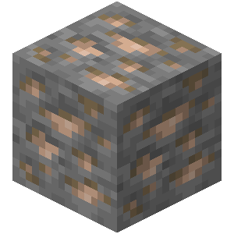
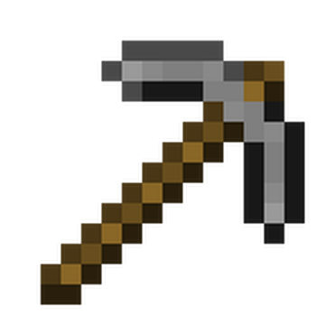
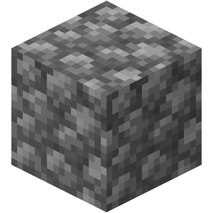
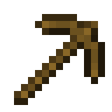
Goal-Oriented Action Planning
Goals → What the player is/should be trying to achieve
Determined by the LLM
Have weights or desires to achieve them
Actions → What the player can perform
Costs associated
Planning → Potential action path to achieve goal
Prioritize lowest cost path/steps
Reevaluate if player is struggling
34
Notes:
Steven
In case you’re not familiar with GOAP, it stands for Goal-Oriented Action Planning, and it’s perfect for supporting players with the variety of goals that they may have.
For regular game AI (like NPCs or enemies), the GOAP architecture will assess what the most important goal is, what actions can lead towards that goal, and plan a sequence of actions based on the lowest cost.
Clearly, this framework can work really well for assisting a player as well. We can use the LLM to identify what the player’s goals are, and GOAP can handle the planning from there. Let’s go through this with our previous example of searching for iron.
Obviously, the goal is to collect a certain amount of iron. The LLM would set the iron collecting desire really high.
In terms of actions, the player would first need to craft and equip a pick capable of mining iron, so at least stone. If they don’t have that, they would first need to craft a wood pick, mine cobblestone, then craft their stone pick. They would then need to either enter a cave, or dig their own mine.
Then, the planner would be able to choose the best path, or set of actions to achieve the goal. This would depend on the player’s environment. If they are currently near a cave, caving might be easier. But if that cave is filled with a bunch of enemies, it may be safer to run away and dig a personal mine.
The best part about GOAP is that goals and paths are easily able to change. So if the player enters that cave filled with enemies, the desire to survive will surpass the desire to collect iron, and the system would be able to recalculate a new plan and assist the player if necessary. Then, when the player is safe, and the survival desire goes back to normal levels, the original goal of collecting iron would take its place, and the player can continue from where they left off.

Slide 35
Goal-Oriented Action Planning
Is the player making progress towards our given objective?
Yes → Hints on next steps as needed
Save plan for future repetition
No → Determine a new objective and plan
Was the LLM wrong?
Did the player change objectives?
Is the current plan/tip not successful/helpful?
35
Notes:
Steven
Now remember, the player’s main goal was determined by the LLM, based on what the player seems to be trying to do, or, what is recommended as a next step.
But just because we make a plan and give the player some tips, doesn’t mean they will necessarily make progress towards that goal.
If they do, that’s great! Clearly, the goal and plan are working, and we can even save this plan in case we need to remind them in the future.
Note here that the player may progress towards the goal but only loosely follow the given plan. For example, they may choose to continue caving even though the planner and tips clearly told them that it’s dangerous. And that’s okay! All we have to do is just update the plan to follow a caving route and give tips related to that, such as bringing extra food and torches.
But what do we do if they’re not progressing?
Was the LLM wrong in determining the goal?
Did the player change objectives?
Is the player struggling to follow the current plan or tips?
Regardless of the reason here, we need to reevaluate, determine the player’s new goal, and/or plan a new set of actions for them. The big advantage of a traditional AI approach like GOAP is that we could even implement UI for players to accept or reject certain portions of this plan.

Slide 36
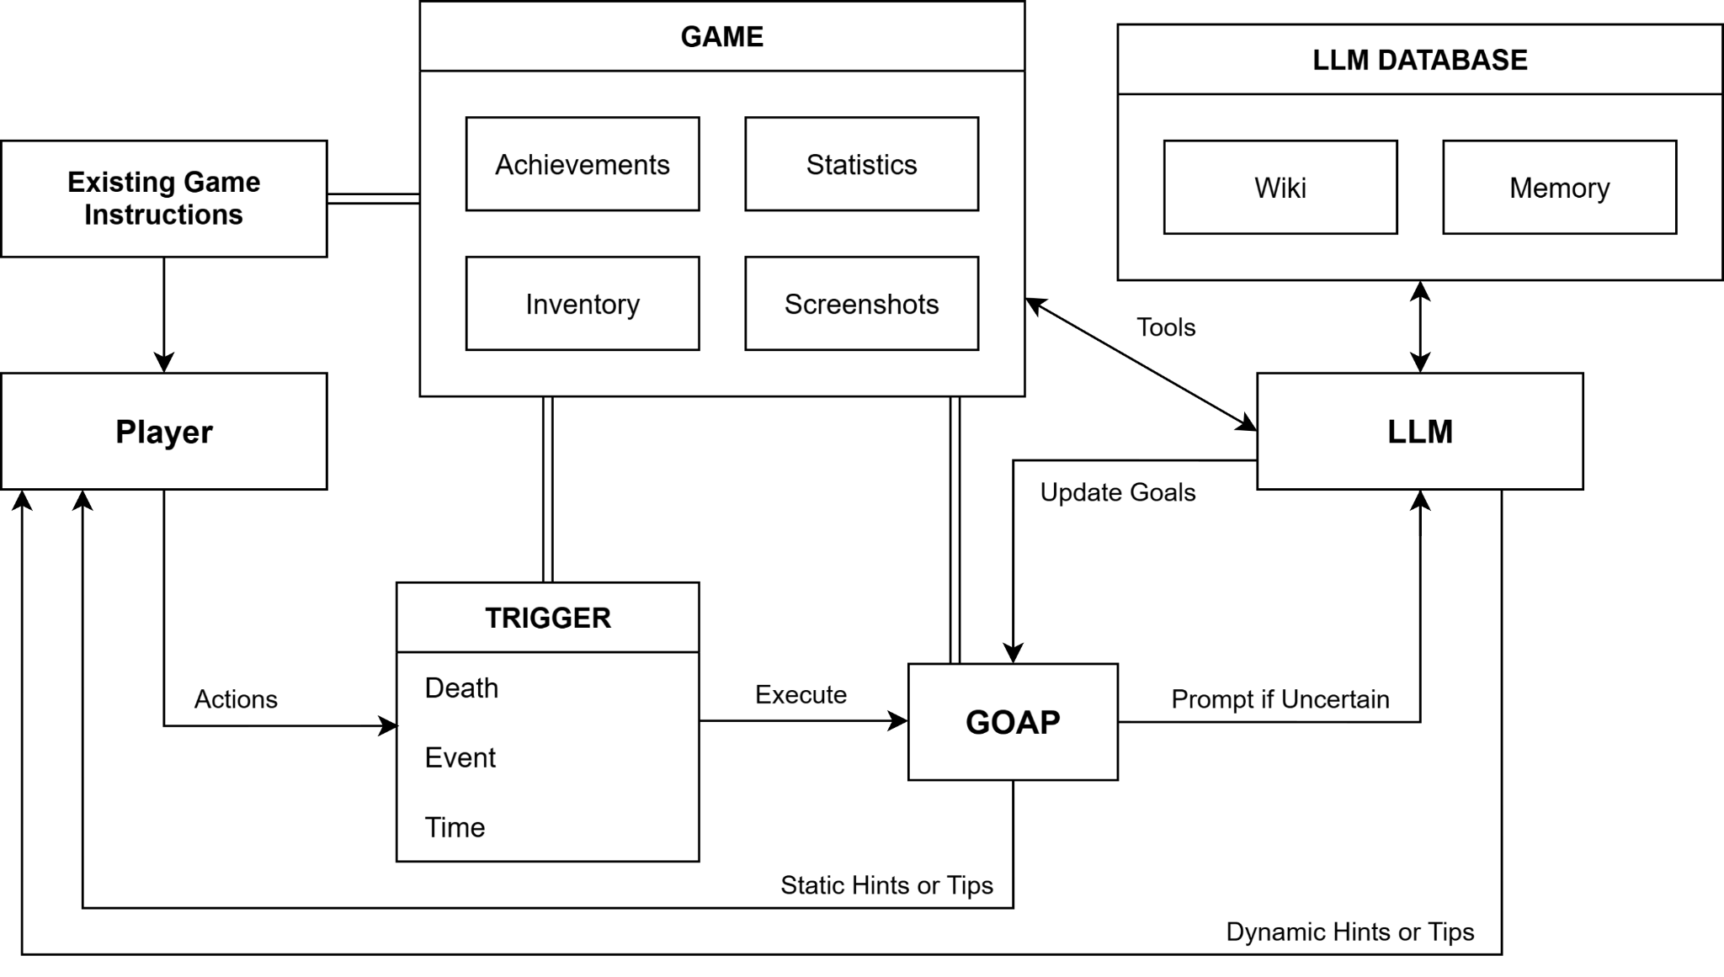
36
Notes:
Steven
Overall, this augmented architecture would look something like this. Now, instead of every trigger invoking the LLM, it instead triggers a comparison of how the player has been progressing versus the GOAP agent. As mentioned if there is only a slight divergence between the player and the GOAP agent’s plan, then everything should be okay and we can simply match the agent’s state to the player’s. Otherwise, if uncertain or diverging too much, reprompt the LLM.
The other thing we’ll highlight here is the static hints or tips provided by the GOAP agent. We don’t just mean the recurring steps or plans here. Since the GOAP agent is hard-coded, it’s super easy for developers to attach static hints to specific goals or sub-goals. For example, crafting goals can automatically come with the crafting recipe, resource gathering goals can automatically come with biome or coordinate instructions, and so on!

Slide 37
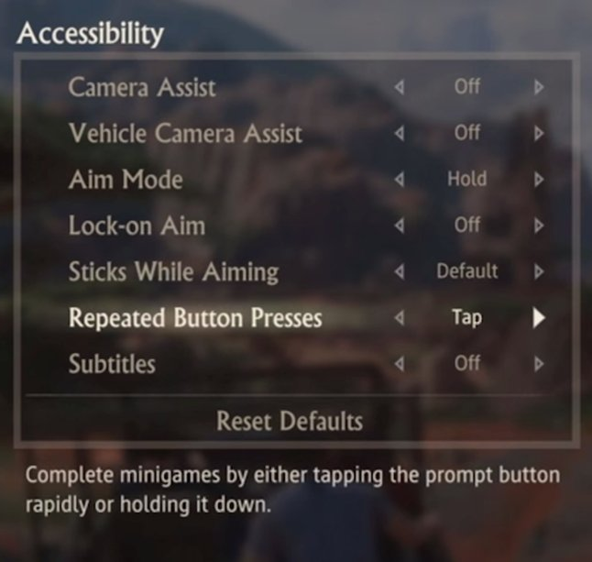
Pros and Cons
Pros
More consistent
Less hallucinations
Less resources
Control over assistance
Cons
Quantifying goals - can this always be done?
More coding
Uncharted 4 - Naughty Dog
37
Notes:
Steven
Adding GOAP to the architecture does address the weaknesses of LLMs, making the assistance more consistent, and it would use less resources as well.
It also gives both developers and players a lot more control over the assistance given, because we would be able to flag each type of assistance so that players can choose which hints they receive, if any. For instance, some players may only want hints after dying to an enemy, while others may prefer more preventative hints that say, tell them to seek shelter because nighttime is coming and monsters are about to spawn. This also allows for players and developers to have more control over the hint format, whether it’s text-based, visual, or audio, and how quickly hints pop up.
Nonika
But even this approach still has its cons. First off is quantifying goals. We’re talking about vast, open-world games here, so the number of potential goals is absolutely massive. Technically, we don’t necessarily need to help players with every minor goal, but for GOAP to plan a set of actions, those sub-goals would still need to be considered.
Also, creating that robust GOAP system for an open-world game, especially a sandbox game, is a LOT of coding, and falls outside of a reasonable scope for a Master’s thesis–that’s why I’m focusing on the LLM portion first to see how far we can get with that alone.

Slide 38
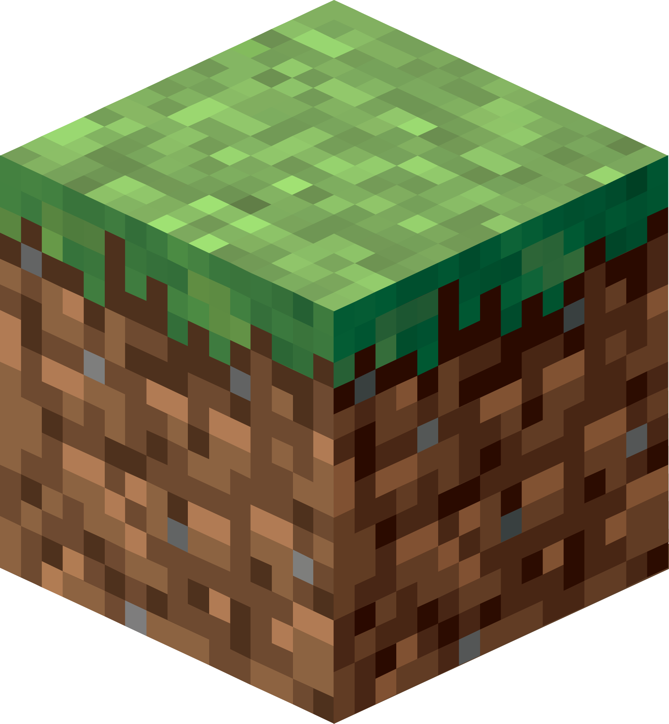

Timeline
Literature Review
Implement
Results
We are here!
Select Game
Experiments
Minecraft - Mojang Studios and Vintage Story - Anego Studios
38
Notes:
Nonika
Where are we in this process? I’m currently doing literature review to see what has been done in the past, what has worked, and what hasn’t.
My next step will be selecting a game for the implementation and experiments. Right now, our two main candidates are Minecraft and Vintage Story. If you haven’t heard of Vintage Story, it started off as a Minecraft mod, but its game mechanics grew so complex that the developers made their own game. Both of these games have mod support, so it’s practical to implement an assistant into them. The main tradeoff is that Minecraft is incredibly popular, while Vintage Story is a smaller indie game. When we choose a game, we will have to consider: do we want our participants to already be familiar with it? Do we want more data online, or less? Do we want the game to be as complex as possible?
We do plan on conducting an informal “experiment” within our research lab to see how players respond to the vanilla gameplay, and what we observe may impact our choice.
In January, I’ll be able to start implementing the mod, finalizing research questions, and get approval for my experiments. For the experiments, we’ll of course have participants play the game, with and without the assistant. Evaluating is where things get a bit tricky. We can definitely compare statistics to see if the assistant is helping players make more progress, or die less. However, arguably the most important part of a game is that it’s fun--so we’ll also do interviews to gather feedback on how the assistant impacts player experience.
By the way, if you have any ideas, thoughts, or comments, please do chat with us after the talk, we would absolutely love to hear them!

Slide 39
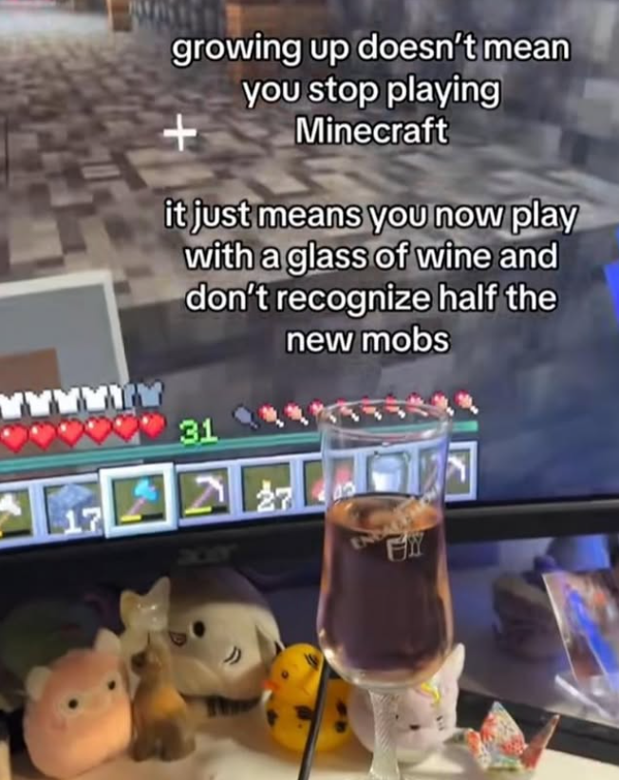
Results
Answers to questions:
Is there a sweet spot for trial and error attempts?
What data is most helpful for LLM?
What’s the best way to prompt?
Are tips accurate/helpful?
Do the tips alleviate cognitive load?
Do players find it helpful?
Is this worth implementing in games?
juice
illegalminecraft - Instagram
39
Notes:
Nonika
In terms of results, we hope to answer the following questions:
Is there a sweet spot for trial and error attempts? So for example, should we display tips only when the player dies, or are preventative tips welcome? How does this relate to player’s experience level? Will beginners get frustrated if they don’t get a tip immediately? Will experienced players get frustrated if they DO get a tip immediately? Or, will they appreciate the help learning the new mobs?
What data is most helpful for LLMs? Is it the initial prompt? The wiki? Something else?
What’s the best way to structure prompts?
Are tips accurate/helpful? How much does the LLM hallucinate? How easily are players able to follow tips?
Do the tips alleviate cognitive load for players? Depending on how many participants we’re able to recruit and if we get a significant sample of players with cognitive disabilities, we may be able to draw some conclusions regarding the accessibility it provides as well.
And of course, the two most important questions we will answer:
Do players like it? Do they find it helpful?
Is this worth implementing in games?
Finding the answers to all these questions will take a while...
In the meantime, let’s take a look at some other ways we can incorporate AI to improve accessibility and cognitive load in games.

Slide 40
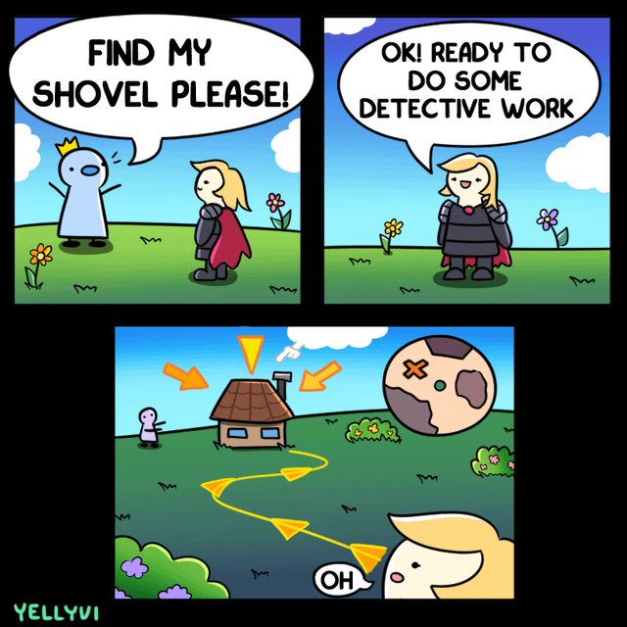
Identifying Stairs
How can you identify cognitive stairs in your game?
The “challenges”?
A consequence of the fun parts of your game!
YellyVi - Reddit
40
Notes:
Nonika
First, let’s discuss how you can identify the metaphorical “stairs” in your game. This is where some people can struggle, because accessibility and user experience improvements are meant to remove challenges for players, right? Technically yes, but “challenge” is a misleading word because game challenges are what make games fun!
In this particular example, the whole point of the quest is to find the shovel, that’s the game challenge, so when the player discovers that the whole quest is already solved and there’s no challenge, they’re understandably upset--there’s nothing for them to do other than walk towards the arrows!
Instead, you can think of the “stairs” in your game as a consequence of the fun parts.

Slide 41
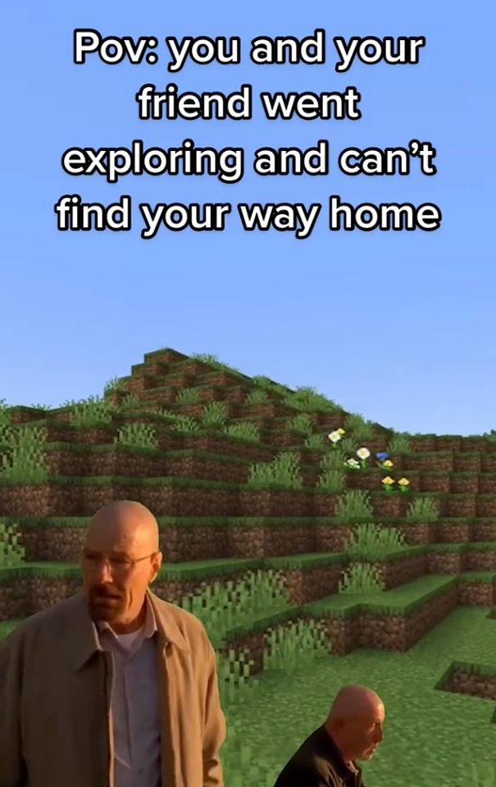
Identifying Stairs
Fun parts:
Rich story
Complex mechanics and items
Gorgeous world to explore
Farming and crafting
Cognitive consequences:
Too much to remember
Overwhelmed by options
A lot to keep track of
thatgirl5arah - TikTok
41
Notes:
Nonika
In terms of the cognitive load specifically, it’s the vastness and complexity of modern games. They have these gorgeous, immersive worlds where you get to truly live in the game, and that’s incredible! But as a consequence, there’s a lot for players to notice, pay attention to, keep track of, learn, and remember.
Let’s go back to our Minecraft example. Minecraft has an infinitely generated world and one of the best parts is wandering around that world, finding cool landscapes, and exploring mineshafts and temples. The consequence is that 3 hours later, you’re thousands of blocks away from home, and you can’t find your way back.

Slide 42
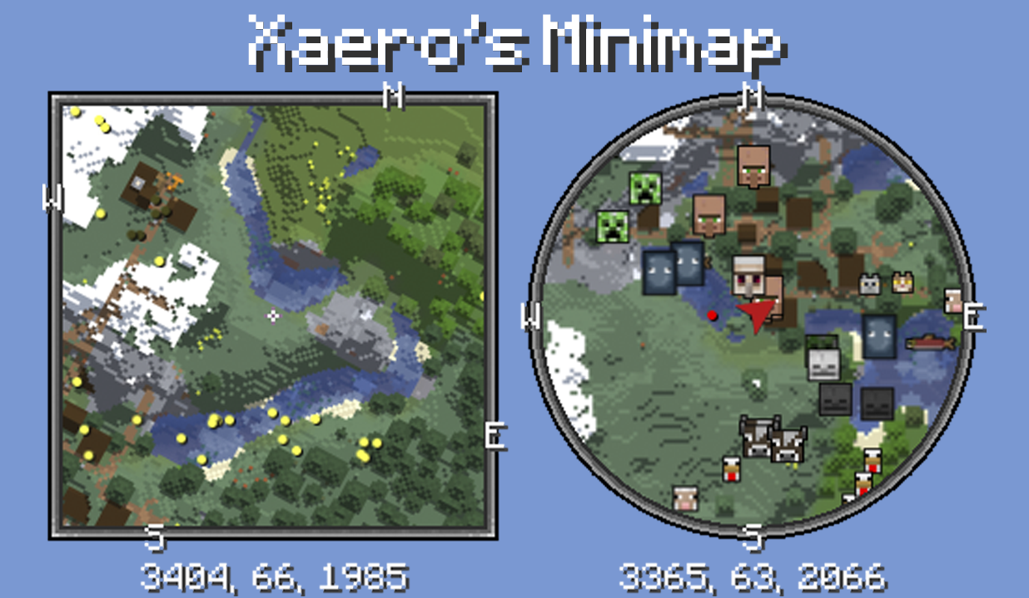
Xaero’s Minimap - Curseforge
42
Notes:
Nonika
That’s why this minimap mod is used in like, every modpack ever. Instead of having the players remember or write down the coordinates of their base and any cool structures they want to revisit, they can save locations as waypoints which display on their map and in their world. Players also have the option of teleporting between waypoints, if they so choose. You’ll notice the HUD includes a minimap with coordinates, a compass, and all the mobs in the area. If you’ve ever played Minecraft with this mod, you know just how much cognitive load it takes off of you. You truly get to focus on the fun parts of Minecraft instead of trying to remember coordinates and directions.

Slide 43
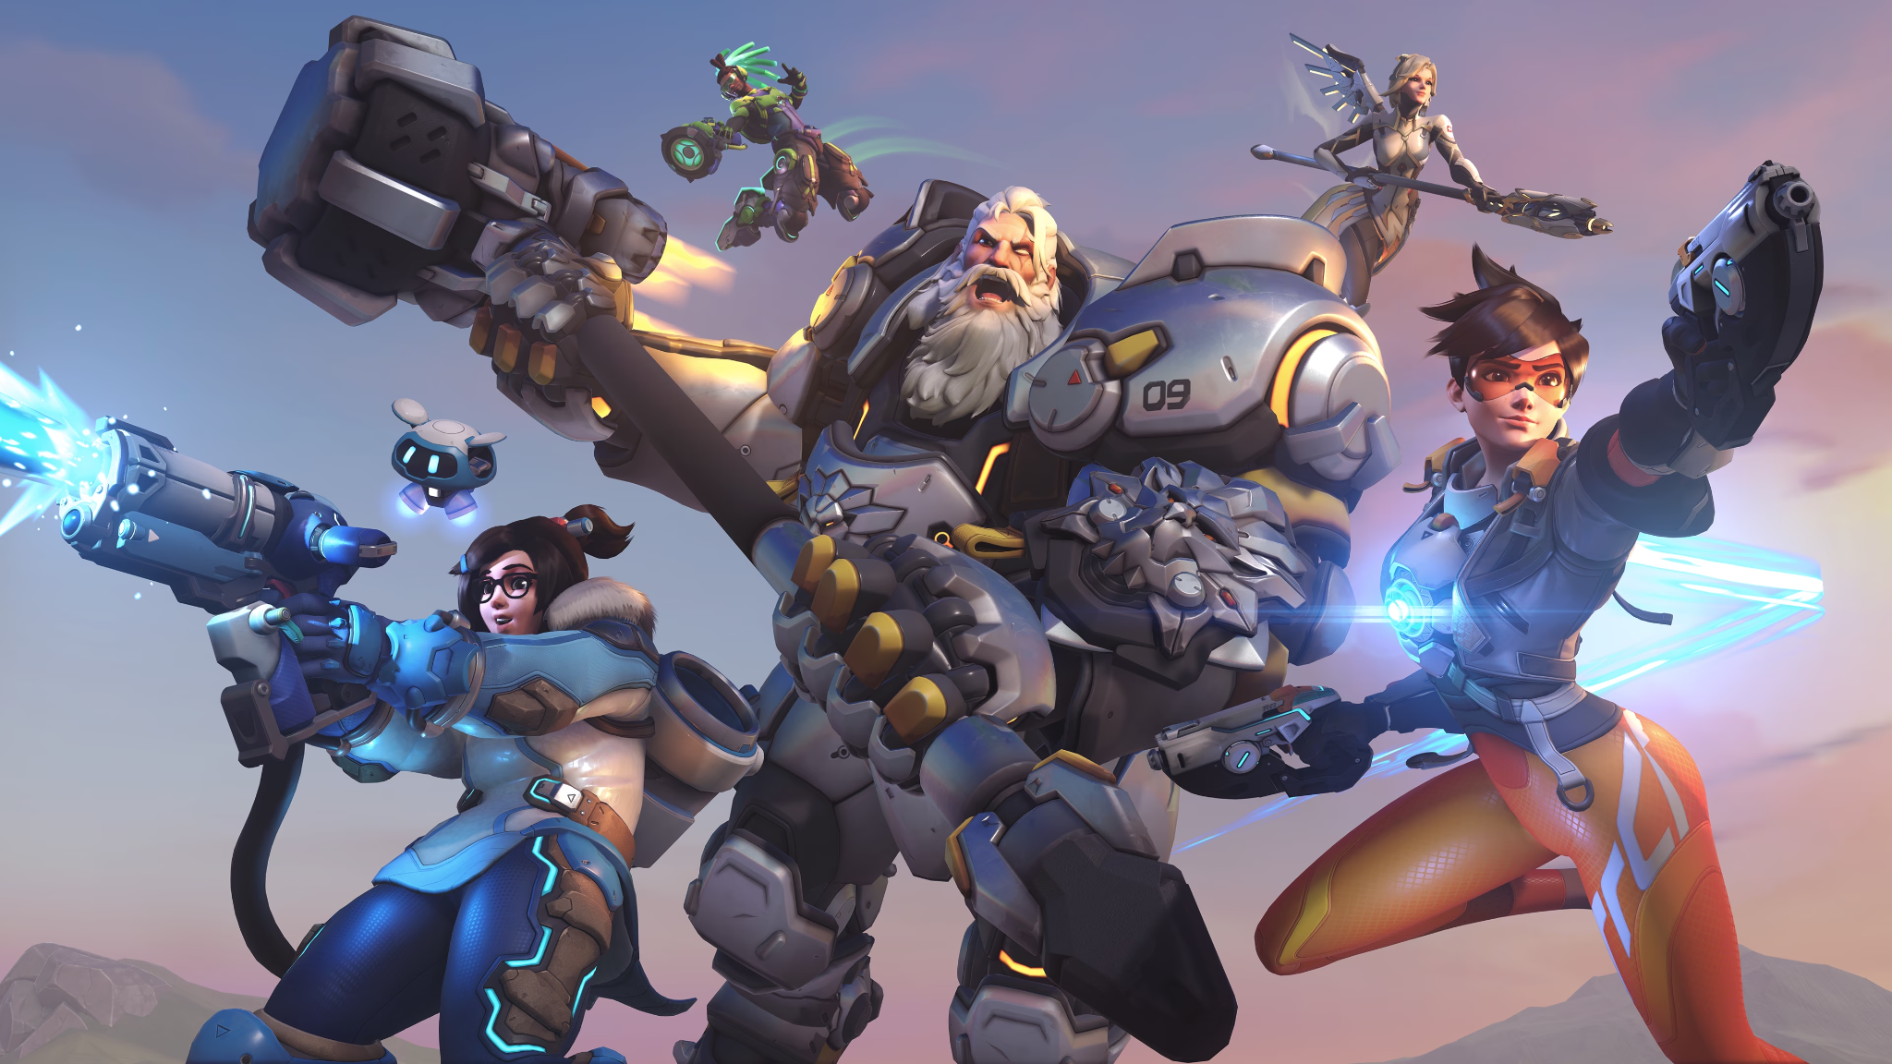
Overwatch - Blizzard Entertainment
43
Notes:
Nonika
Now that we understand how to identify cognitive challenges, let’s take a look at some AI solutions for games. These ideas are going to be a lot easier to implement than my research, and they’re certainly not the only possible methods. We just want to get you thinking creatively about what you can do with AI!
Let’s start with fast-paced PVP games, like Overwatch.

Slide 44
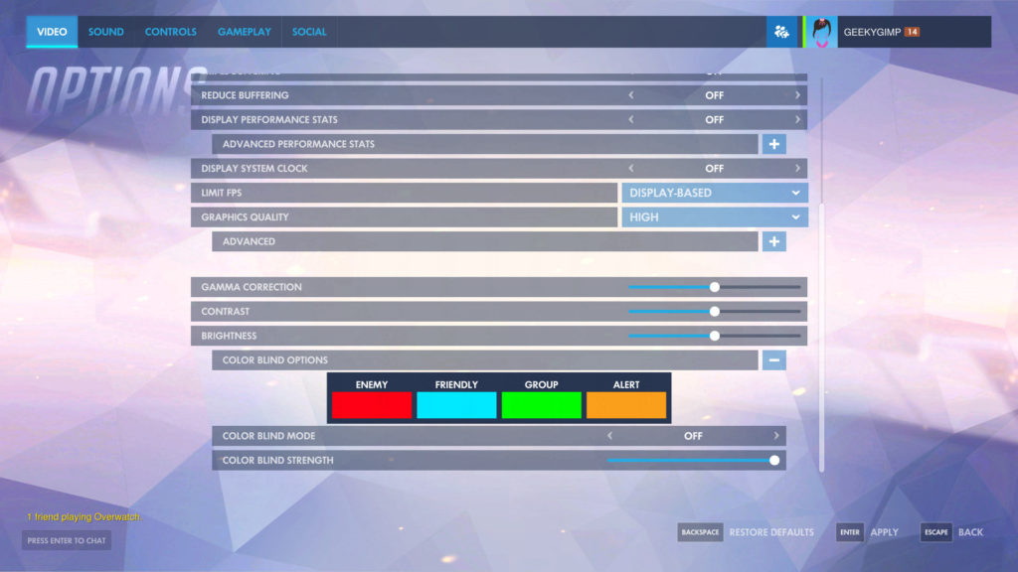
Overwatch - Blizzard Entertainment
44
Notes:
Nonika
Overwatch is actually known for having some of the most in depth accessibility settings in gaming history. You can remap any button, change any colour, even customize your crosshair! But like many modern games, especially PVP shooter games, there is a significant cognitive load for players.

Slide 45
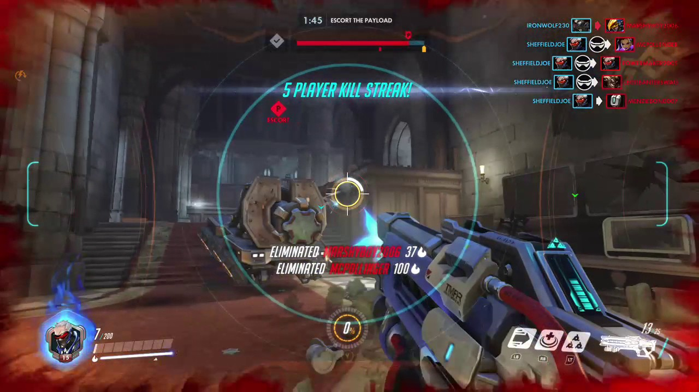
Overwatch - Blizzard Entertainment
45
Notes:
Nonika
I mentioned before how it can be hard to pay attention to everything happening in a massive teamfight. And the HUD does help draw the player’s attention to certain things, like their low health, indicated by the red vignette. But what now? Where’s the nearest health pack? If your players are focused on say, killing enemies, not dying, and pushing the objective, it may take them a long time to learn all the map layouts and all the little corners with hidden health packs.
If you’ve implemented enemy AI in your game and they’re able to pathfind to the nearest health pack, or other key items using A*, well, there’s your solution! It’s super easy to use that same function to display paths on your players’ HUD which could help them learn map layouts!

Slide 46
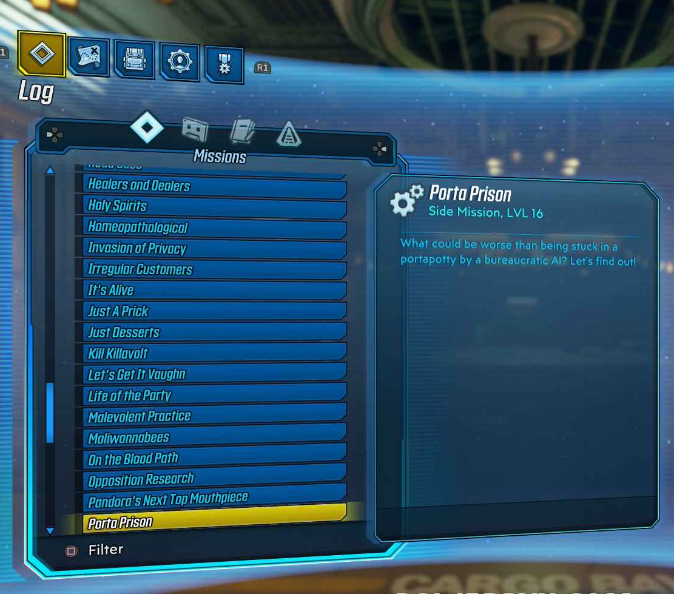
Traditional AI
Guide main versus side quests
Planner system suggests side quests before a new main quest
Quests along path
Time investment
Difficulty
Rewards
Borderlands 3 - Gearbox Software
46
Notes:
Steven
What else can we do with traditional AI methods? Well, we could potentially apply it to the overwhelming quest problem. If the fun part of your game is that there’s a rich world with a TON of quests, the consequence is that your players now have to decide which ones to focus on. If they’re running across the map for a quest, are there any mini quests that they can take care of along the way?
Speaking of “mini quests”, your player has stayed up until midnight and they should really get to sleep… but they do have time for one more quest, if it’s short… but how can they tell which one is actually short, and which one seems short until it’s an hour later and HOW is it still going?
Suggestions by difficulty and rewards could also be super helpful, but may be a bit tricker to implement depending on your game. Overall, helping your players sort through quests can help prevent your players from getting overwhelmed, and keep them focused on the fun questing part for longer!

Slide 47
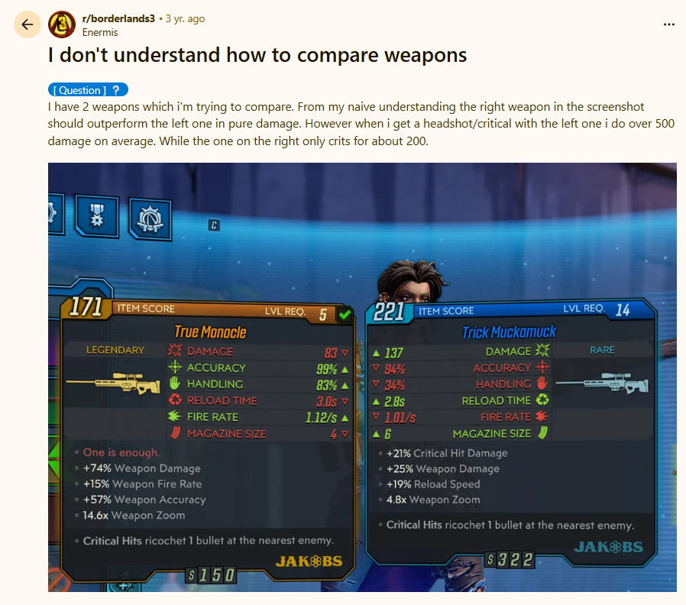
Generative AI
Recap the story so far
Summarize current task
Item suggestions:
Strength
Comparison
Playstyle
Preference
Enermis - Reddit
47
Notes:
Steven
In terms of Generative AI, as we know, it’s very good at summarizing long text. As such, we can easily use it to recap the story so far, or summarize the current task for players who maybe haven’t played the game in a few weeks. It could also be very helpful in providing players with item suggestions, especially in games with randomized statistics. In this example, the Legendary weapon on the left seems like it does less damage, but it also has a special effect which makes it more powerful in practice. It has the tagline “One is enough” but clearly that doesn’t really explain what it does. So it could be helpful to use Generative AI to summarize your game’s instructions, documentation, or wiki on a much smaller scale in comparison to Nonika’s research. It could also be helpful to choose a set of weapons or items to create a loadout for the player based on their playstyle or preferences.

Slide 48
PRESS A FOR ASSISTANCE
Making Games Accessible With AI
Thank you for listening & stay tuned!
Notes:
Nonika
Thank you all for having us and for listening! When we get back to Canada, I’ll keep working on my research and figure out what works, what doesn’t, and how players feel about LLM-generated tips, so stay tuned for those results! It might take a bit so feel free to connect with us…

Slide 49


Nonika
nonika.ca
Steven
StevenRice.ca
Notes:
Nonika
We also hope that we sparked some thoughts and ideas on how to incorporate AI assistance into our beloved games, and we are excited to hear any questions or comments you have!

